Slide 1

Computer Networks
王廷
华东师范大学 软件工程学院 Email: twang@sei.ecnu.edu.cn
Office: 理科大楼B1116室

Slide 2
Chapter3：The Data Link Layer
Data Link Layer Design Issues 》数据链路层设计要素
Error Detection and Correction 》检错与纠错
Elementary Data Link Protocols 》基本的数据链路协议
Sliding Window Protocols 》滑动窗口协议
Example Data Link Protocols 》数据链路协议实例

Slide 3
The Data Link Layer
Responsible for delivering frames of information over a single link
Object： reliable, efficient communication between two adjacent machines
主要作用：确保相邻节点之间实现高可靠、高效、透明的数据传输。
Application
Transport
Network
Link
Physical

Slide 4
Functions of the Data Link Layer
将物理层的无结构原始比特流划分成一定长度的结构数据单元—帧（Frame），即组帧（Framing）。
Provide service interface to the network layer向网络层提供一个定义良好的接口
Dealing with transmission errors处理传输错误
对帧进行差错控制（error control），实现检错/纠错功能
Regulating data flow调节数据流
通过合适的流量控制（flow control）协议保证收发双方的传输同步。
Slow receivers not swamped by fast senders确保慢速的接收方不会被快速的发送方淹没

Slide 5
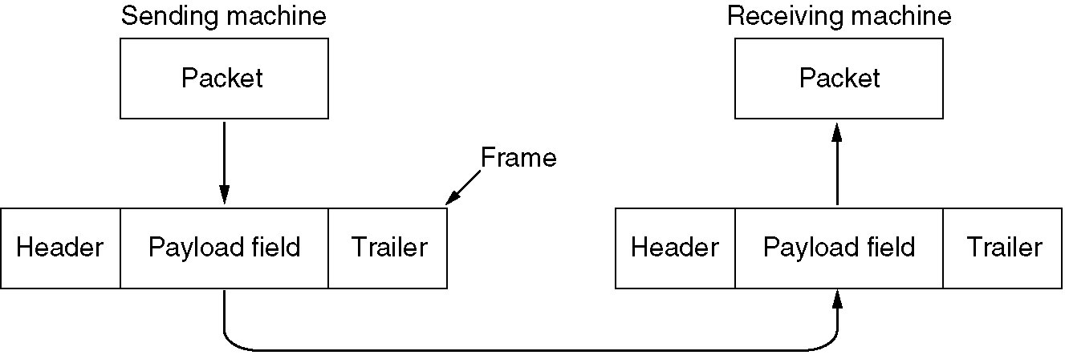
Functions of the Data Link Layer
Relationship between packets and frames.

Slide 6
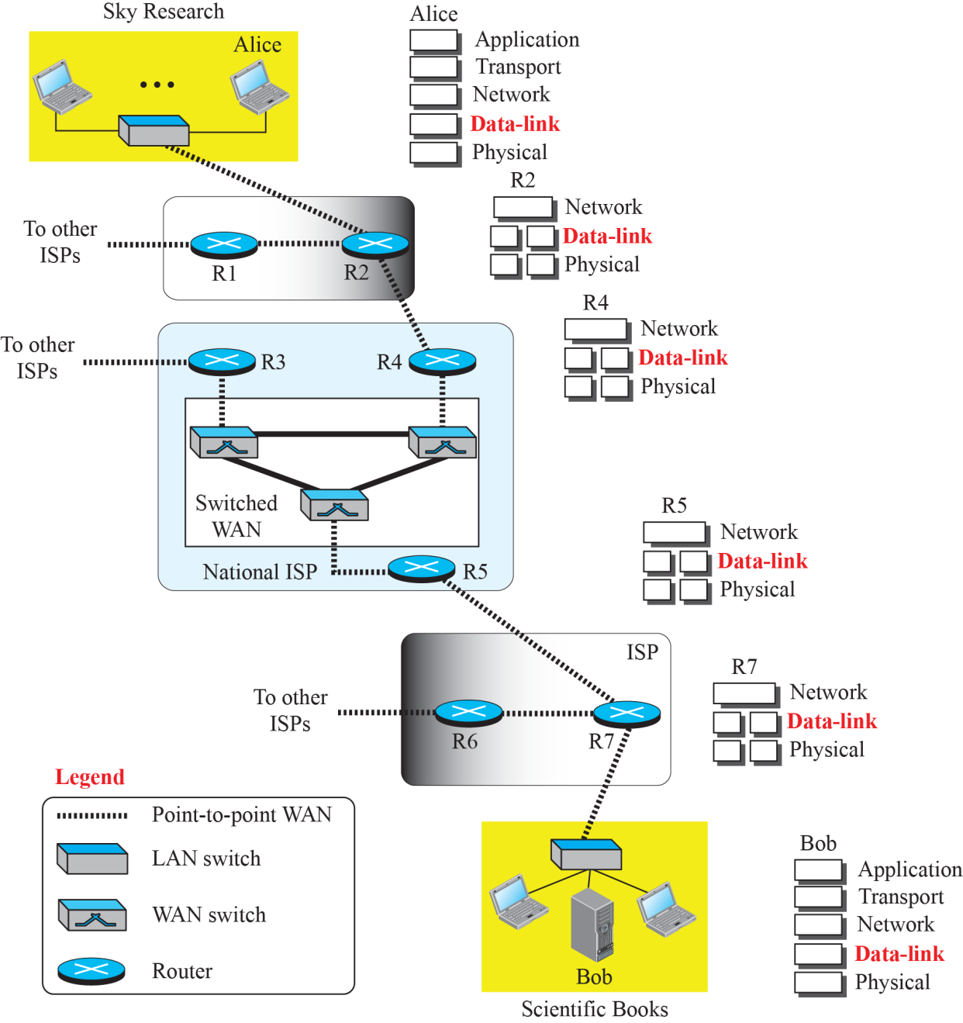
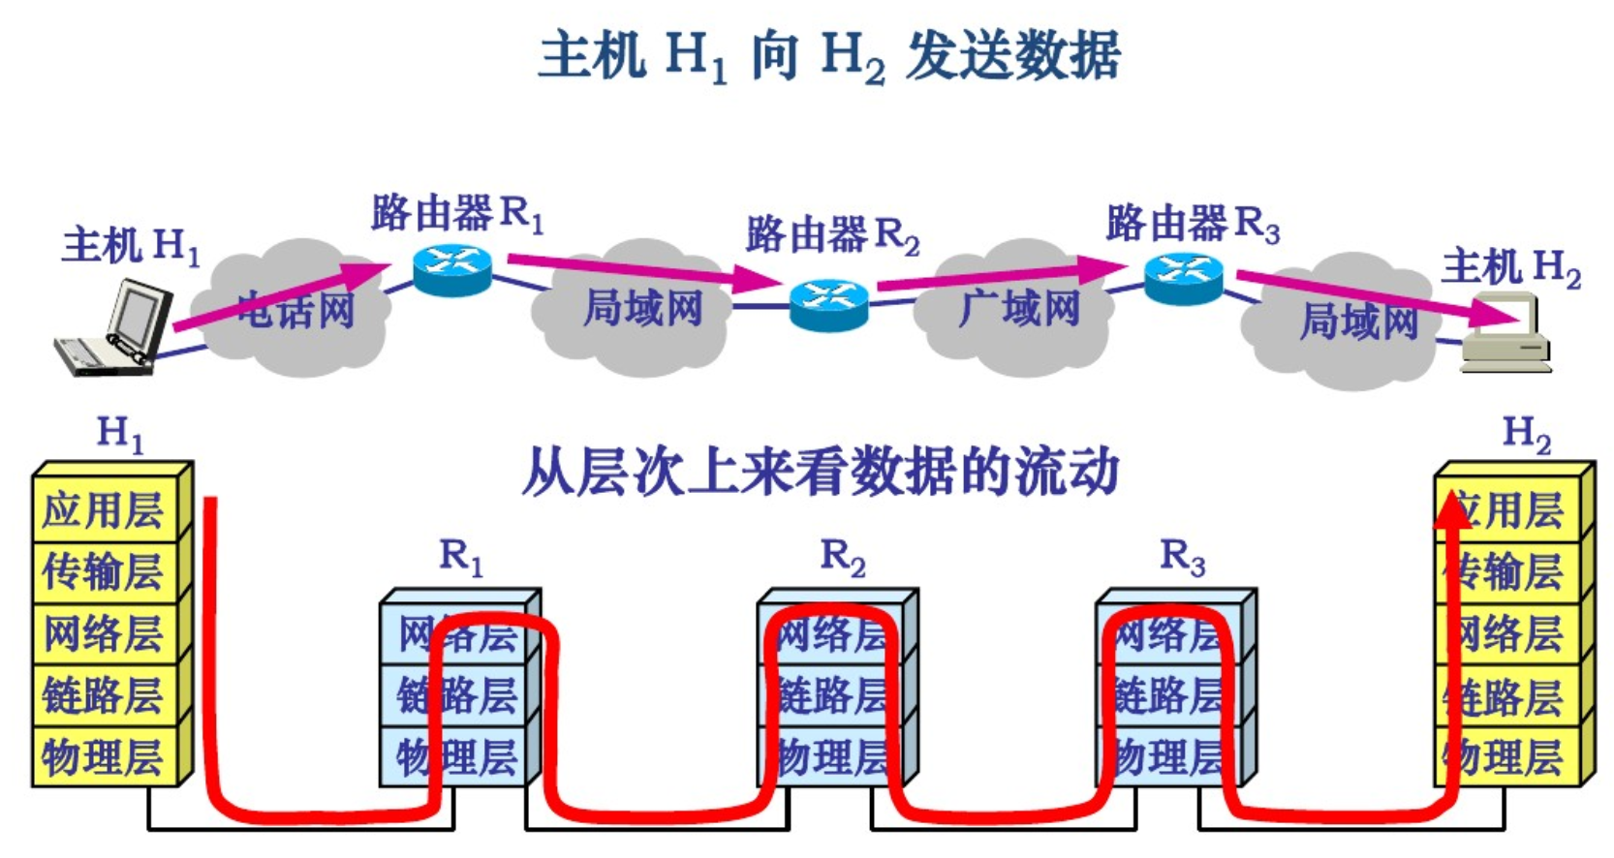
Communication at the data link layer

Slide 7
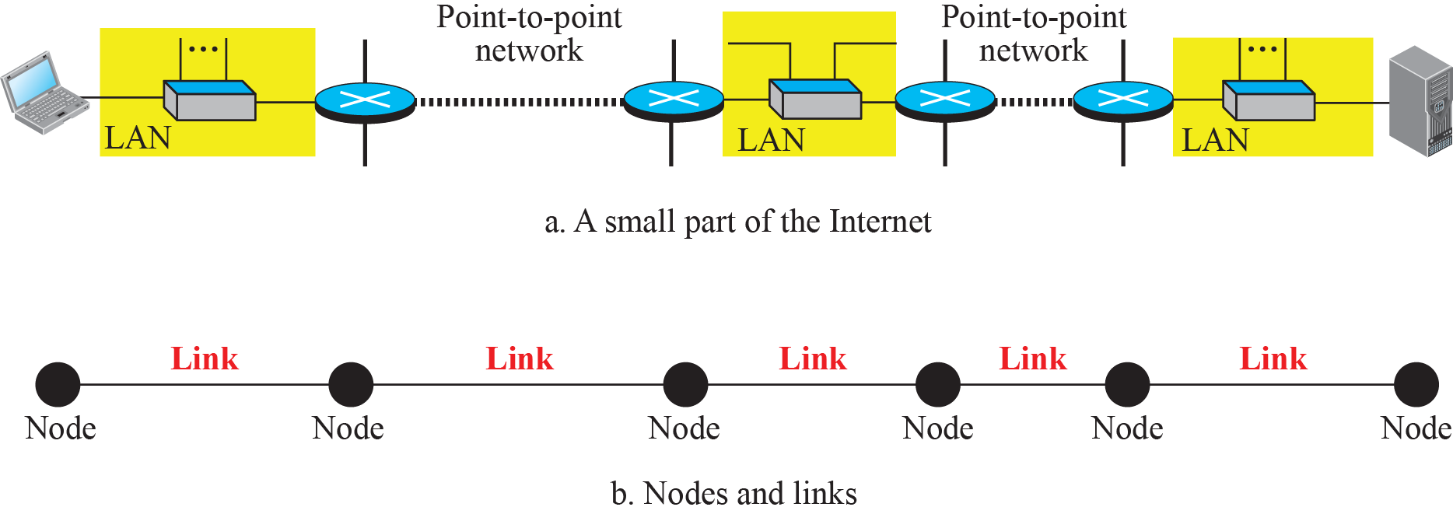

Nodes and Links
节点：end hosts and routers/switches
链路：逻辑上指两个通信主机之间的网络
链路link：一条无源的、点到点的物理信道（中间无任何交换节点）
数据链路data link：通过通信协议来控制链路上数据的传输。

Slide 8
Two Categories of Links
A point-to-point link uses the whole capacity of the medium.
dedicated to the two devices
Using HDLC or PPP package, without addressing, the address field is fixed at FF.
E.g., when two friends use the traditional home phones to chat, they are using a point-to-point link;
A broadcast link uses only part of the capacity of the link.
shared between several pairs of devices.
Ethernet link, involving IP and MAC, which realizes mapping by ARP
E.g., when the same two friends use their cellular phones, they are using a broadcast link (the air is shared among many cell phone users).

Slide 9
Two Sublayers of the Data Link Layer
Data Link Control (DLC) sublayer deals with all issues common to both point-to-point and broadcast links.
Media Access Control (MAC) sublayer deals only with issues specific to broadcast links.

Slide 10
Data Link Layer Design Issues
Frames » 帧
Possible Services » 可提供的服务
Framing methods » 组帧方法
Error control » 差错控制
Flow control » 流量控制

Slide 11
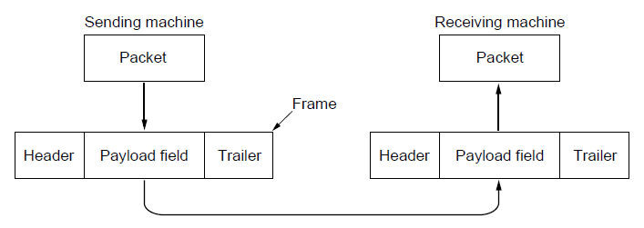
Frames
Link layer accepts packets from the network layer, and encapsulates them into frames that it sends using the physical layer; reception is the opposite process
Network
Link
Virtual data path
Physical
Actual data path
Reason for encapsulation and decapsulation:
- the link-layer addresses are normally different
- each link may be using a different protocol with a different frame format.

Slide 12
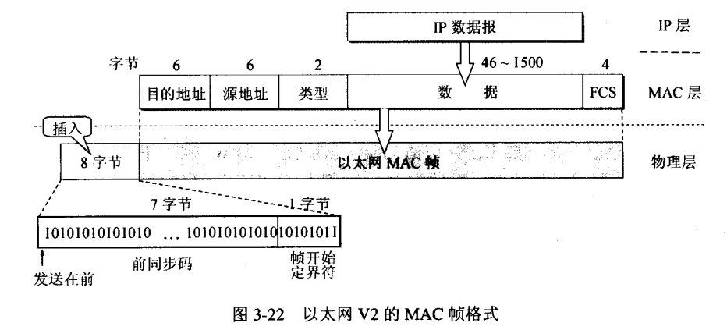
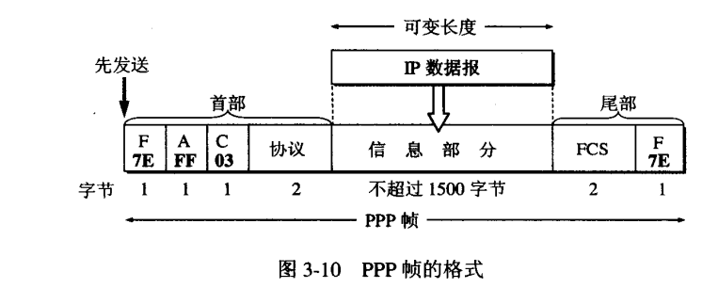
Frame Format
数据帧（Data frame），就是数据链路层的协议数据单元，它包括三部分：帧头，数据部分，帧尾。其中，帧头和帧尾包含一些必要的控制信息，比如同步信息、地址信息、差错控制信息等；数据部分则包含网络层传下来的数据，比如IP数据包，等等。
不同的数据链路层协议对应着不同的帧，所以，帧有多种，比如以太网帧/MAC帧、PPP帧等，其具体格式也不尽相同。
以MAC帧为例，以太网上使用两种标准帧格式。第一种是上世纪80年代初提出的DIXv2格式，即EthernetII帧格式。EthernetII后来被IEEE802标准接纳，并写进了IEEE802.3x-1997的3.2.6节。第二种是1983年提出的IEEE802.3格式。

Slide 13
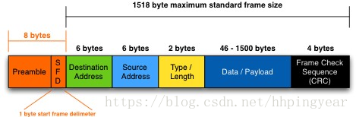
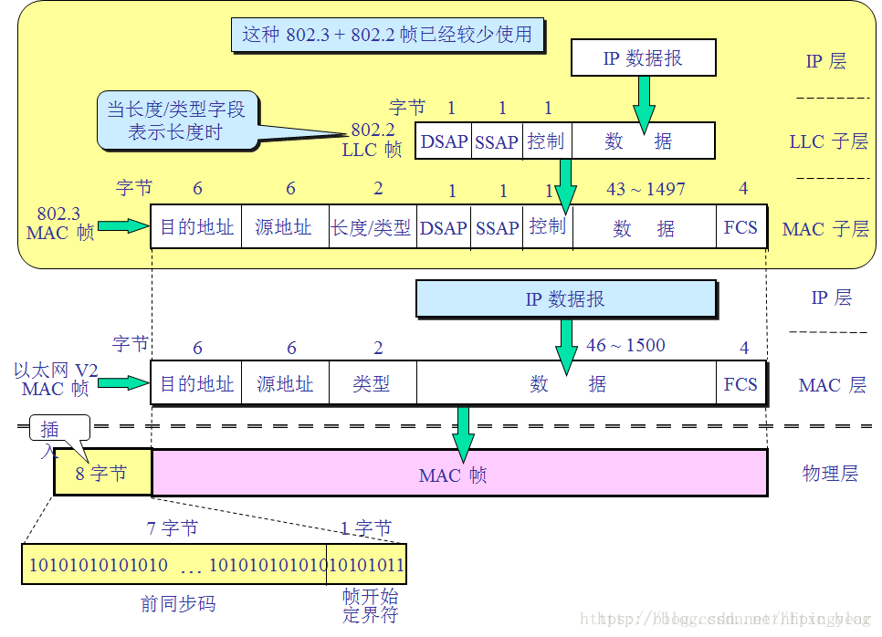
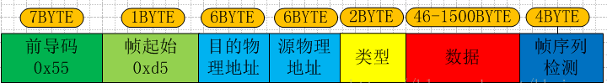
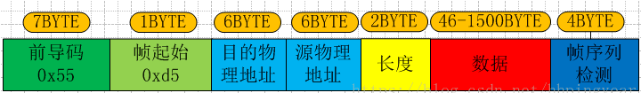

Frame Format
最常用的 MAC 帧是以太网V2的格式
IEEE 的 802.3 标准

Slide 14
Possible Services
Unacknowledged connectionless service无确认的无连接服务（局域网）
Frame is sent with no connection / error recovery
Ethernet is example
Acknowledged connectionless service有确认的无连接服务（无线通信）
Frame is sent with retransmissions if needed
Example is 802.11
无线通信，信道使用率很低但数据传输的误码率相对较高，确认是必要的
Acknowledged connection-oriented service有确认的有连接服务
Connection is set up; rare

Slide 15
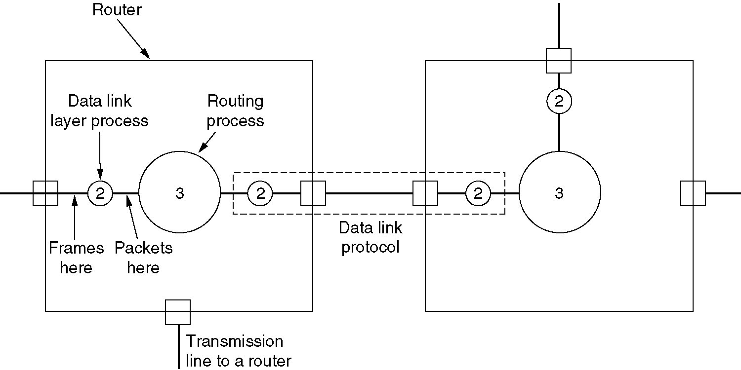
Services Provided to Network Layer

Slide 16
Framing Methods
Framing: breaking up the bit stream into frames将原始的位流分散到离散的帧中，叫成帧/组帧。
数据链路层将比特组合成帧作为传输单位，是为了在出错时只重发出错的帧，而不必重发所有数据，为了能使接收方能正确的接收并检查所接收的帧，发送方必须依据一定的规则把网络层递交的分组封装成帧（即组帧）。组帧主要解决帧定界，帧同步，透明传输等问题。
主要有以下4种组帧方法：
Byte count » 字节计数法
Flag bytes with byte stuffing » 带字节填充的标志字节法
Flag bits with bit stuffing » 位填充的位标志法
Physical layer coding violations » 物理层违例编码法
Use non-data symbol to indicate frame

Slide 17
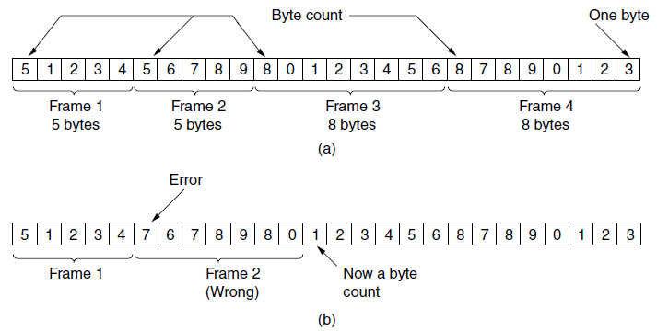
Framing – Byte count 字节计数法
在帧头部使用一个计数字段来标明帧内字节数，当目的节点接收到字节计数值时就知道后面跟随的字节数，从而可以确定帧结束的位置（计数字段提供的字节数包含自身所占用的一个字节），这种方法最大的问题，如果计数字段出现了错误，即失去了帧边界划分的依据，接收方就无法判断所传输帧的结束位和下一帧的开始位，收发双方将失去同步。
Simple, but difficult to resynchronize after an error
Expected case
Error case
A byte stream. (a) Without errors. (b) With one error.

Slide 18
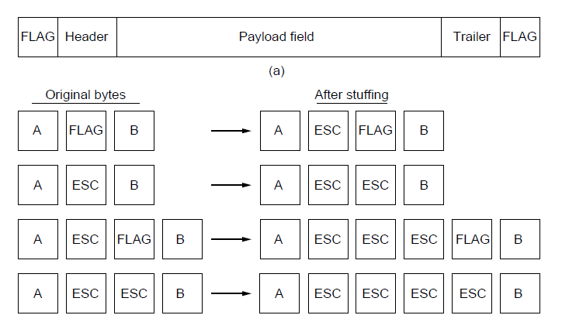
Framing – Byte stuffing 带字节填充的标志字节法
字节填充法是采用一些特殊字符（FLAG）来定界一帧的开始和结束的方法过去采用的开始和结束字不同的，但近几年多数协议倾向于采用使用相同的字节，称为标志字节(flag byte)。
为了使信息位中出现的特殊字符避免被误判为帧的首尾定界符，可以在特殊定位符前面填充一个转义字符（ESC）来区分（p.s. 转义字符是ASCII码中的控制字符，是一个字符，而非“E”,“S”,“C”三个字符的组合），以实现数据的透明传输。而在接收端的数据链路层在把数据送往网络层之前删除这个插入的转义字符。这种技术称为字节填充(byte stuffing)。
如果用来填充的转义字符出现在待发送的数据信息当中，又该如何处理呢?答案仍是在出现的这个转义字符前插入一个转义字符。
缺点：1.依赖于8位字符；2. Longer, but easy to resynchronize after error。
Frame format
Need to escape extra ESCAPE bytes too!
Four Stuffing examples

Slide 19
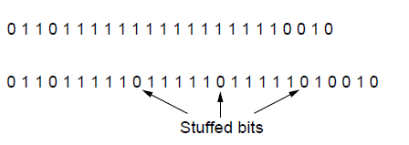
Framing – Bit stuffing位填充的位标志法
Stuffing done at the bit level:
Each frame begins and ends with a special bit pattern, 01111110 or 0x7E in hexadecimal. This pattern is a flag byte.
比特填充法既允许数据帧包含任意长度的字符，也允许每个字符有任意长度的位
为了不使信息位中出现比特流01111110被误判为帧的首尾标志,
发送方的数据链路层在信息位遇到5个1则会自动在后面插入一个0；
接收方做该过程的逆操作，即每收到5个连续的1时，则自动删除后面紧跟着的0，以恢复原信息。
USB uses bit stuffing.
Data bits
Transmitted bits
with stuffing

Slide 20
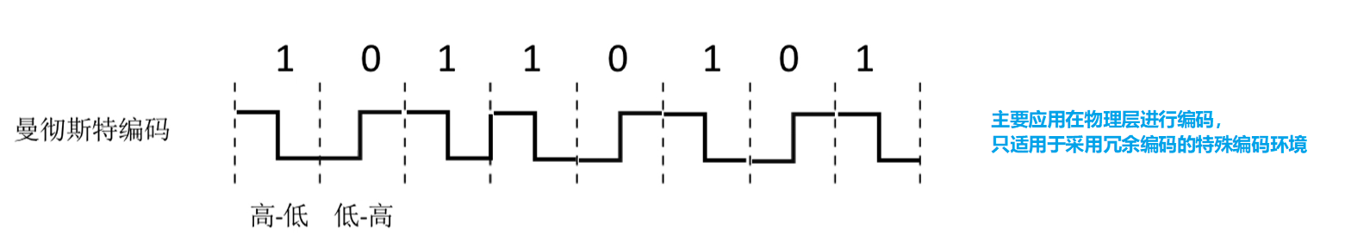
Framing – Physical layer coding violations物理层违例编码法
在物理层比特编码时通常采用违规编码法，例如曼彻斯特编码方式，将'1'编码成“高-低”电平对，将数据比特'0'编码成“低-高”电平对。而“高-高”电平对和“低-低”电平对在数据比特是违规的（即没有采用）。可以利用这些违规编码来定界帧的起始和终止。局域网中IEEE 802就采用了这种方法。
违规编码法不需要采用任何填充计数，便能实现数据传输的透明性，但它只适用于采用冗余编码的特殊编码环境。 由于字节计数法中计数字段的脆弱性和字符填充法实现的复杂性与不兼容性，目前较常用的组帧方法是比特填充法和违规编码法。

Slide 21
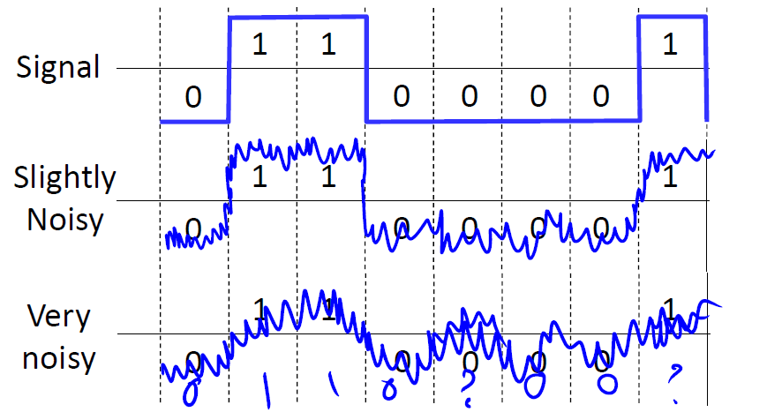
Dealing with transmission errors

Slide 22
Error Control
Error control repairs frames that are received in error
Requires errors to be detected at the receiver （Detecting errors and retransmissions are next topics.）
For unacknowledged connectionless service, it might be fine.
For reliable connection-oriented service, it should provide feedbacks.
Receiver: send special control frames bearing positive or negative acks.
Typically retransmit the frame with negative acknowledgement.
Timer protects against lost acknowledgements or lost frames
When the sender transmits a frame, it starts a timer.
Retransmit the frame whenever the timer goes off.
Frames may be retransmitted multiple times, and the receiver will pass the same frame to the network layer more than once. To prevent this, to assign sequence numbers to outgoing frames so that the receiver can distinguish retransmissions.

Slide 23
Flow Control
Prevents a fast sender from out-pacing a slow receiver.
Two approaches:
Feedback-based flow control: seen at both link layer and higher layers.
Receiver gives feedback to the send giving it permission to send more data.
Rate-based flow control: only seen in the transport layer.
The protocol built-in mechanism that limits the rate at which sender may transmit data, without using feedback from the receiver.
Rare in the Link layer as NICs run at “wire speed”
Flow control is a topic in the Link and Transport layers.

Slide 24
Chapter3：The Data Link Layer
Data Link Layer Design Issues 》数据链路层设计要素
Error Detection and Correction 》检错与纠错
Elementary Data Link Protocols 》基本的数据链路协议
Sliding Window Protocols 》滑动窗口协议
Example Data Link Protocols 》数据链路协议实例

Slide 25
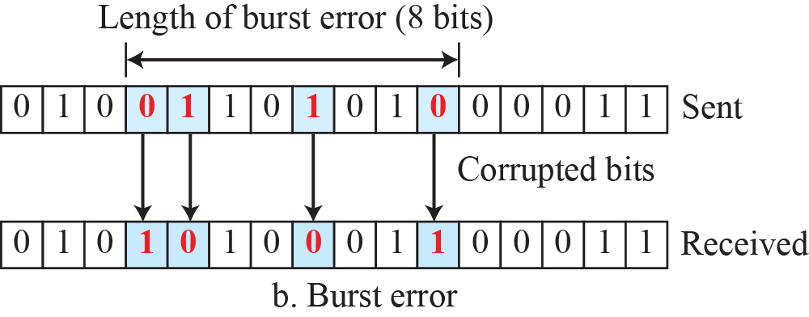
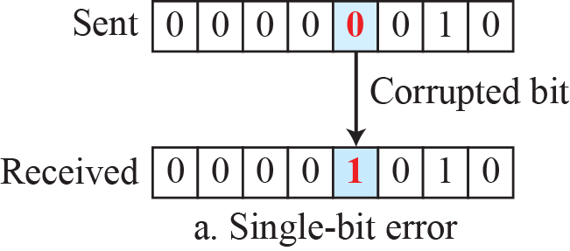
Type of Errors
Single-bit error means that only 1 bit of a given data unit (such as a byte, character, or packet) is changed from 1 to 0 or from 0 to 1.
Burst error means that 2 or more bits in the data unit have changed from 1 to 0 or from 0 to 1.

Slide 26
Error Detection and Correction
Error codes add structured redundancy to data so errors can be either detected, or corrected.
The correction of errors is more difficult than the detection.
In error detection, we are only looking to see if any error has occurred. The answer is a simple yes or no. We are not even interested in the number of corrupted bits. A single-bit error is the same for us as a burst error.
In error correction, we need to know the exact number of bits that are corrupted and, more importantly, their location in the message.

Slide 27
Error Detection and Correction
Error correction codes:
Hamming codes » 海明码
Binary convolutional codes » 二进制卷积码
Reed-Solomon Codes » 里德-所罗门编码RS
Low-Density Parity Check codes » 低密度奇偶校验LDPC
Error detection codes:
Parity » 奇偶
Checksums » 校验和
Cyclic redundancy codes » 循环冗余校验

Slide 28

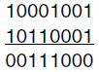
Error Bounds – Hamming distance
Code turns data of m bits into codewords码字 of n bits (n=m data bits + r redundant check bits.)
(n,m) code (n-bit codeword). the total length of a block is n (i.e., n=m+r).
Hamming distance is the minimum bit flips to turn one valid codeword into any other valid one.
Richard W. Hamming (1915-1998)，1968年图灵奖获得者
To determine how many bits differ, just XOR two codewords and count the number of 1 bits.
This pair has a Hamming distance of 3.
Hamming distance of a code is the minimum distance between any pair of valid codewords.
Example with 4 10-bits codewords:
0000000000, 0000011111, 1111100000, and 1111111111
Hamming distance is 5

Slide 29
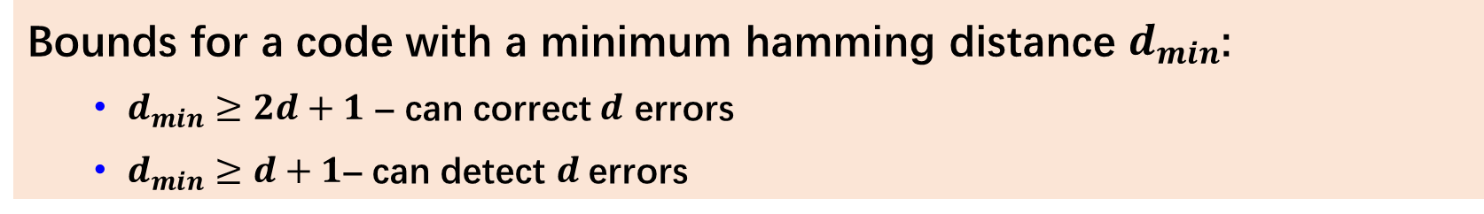
Error Bounds – Hamming distance
Error detection:
For a code of distance d+1, up to d errors will always be detected.
因为从一个正确的码字出发任意走d步（也就是最多有d个位出错）都不会到达另外一个正确的码字，但是走d+1步就有可能到达另外一个正确码字，也就是说错了d+1个位以后被当成无错的码字接受。
Error correction:
For a code of distance 2d+1, up to d errors can always be corrected by mapping to the closest codeword.
因为从一个正确的码字出发任意走d步都还是离这个码最近，离另外一个正确的码字至少有d+1步距离，因此纠错时只要知道错误不超过d位就能够将其对应纠正到最近的正确码字。
Bounds for a code with a minimum hamming distance $d_{min}$:
$d_{min}≥2d+1$ – can correct $d$ errors
$d_{min}≥d+1$– can detect $d$errors

Slide 30
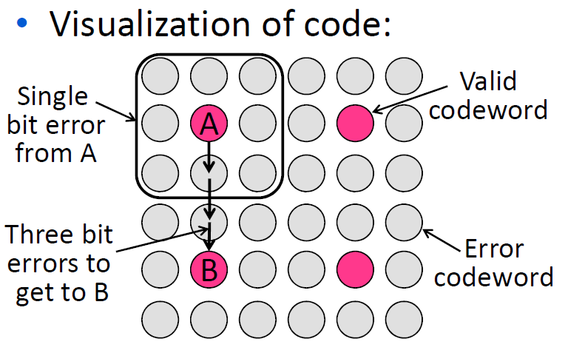
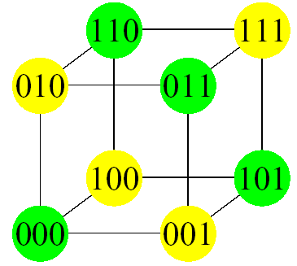
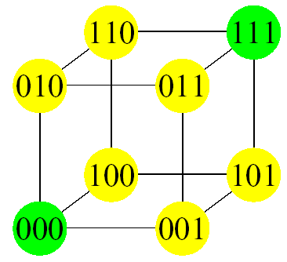
HDistance=2
HDistance=3

Slide 31
Minimum Hamming distance
Find the minimum Hamming distance of the following coding scheme:
00000, 01011, 10101, 11110
d_{min} in this case is 3
This code can detect up to two errors,
and it can correct up to one error.

Slide 32
Linear Block Codes线性分组码
Almost all block codes used today belong to a subset called linear block codes.
A linear block code is a code in which the result of XORing any codeword with any other codeword is a valid codeword.
E.g., the code schemes on the previous slides
00000, 01011, 10101, 11110
00000
01011
-----
01011
01011
10101
-----
01011
10101
11110
-----
01011
00000
11110
-----
11110
00000
10101
-----
10101
01011
11110
-----
10101

Slide 33
Error Correction Codes纠错码
Retransmission of corrupted and lost packets is not useful for real-time multimedia transmission.
Forward Error Correction (FEC 前向纠错) is used to correct the error or reproduce the packet immediately.
前向纠错编码（FEC）技术通过在传输码列中加入冗余纠错码，在一定条件下，通过解码可以自动纠正传输误码，降低接收信号的误码率。
Hamming codes »
Binary convolutional codes »
GSM mobile phone system, satellite communications
Reed-Solomon (RS) and Low-Density Parity Check codes
Mathematically complex, widely used in real systems
RS codes: DSL, data over cable, satellite communications, CDs, DVDs, and Blu-ray discs(蓝光光盘)
LDPC codes: digital video broadcasting, 10Gbps Ethernet, power-line network, latest version of 802.11

Slide 34
Hamming Codes
Hamming codes provide for FEC using a “Block Parity”
Allows correction of single bit error
This is accomplished by using more than one parity bit奇偶校验位
Each computed on different combination of bits in the data

Slide 35
Parity Check奇偶校验
奇偶校验(Parity Check)是一种校验代码传输正确性的方法。根据被传输的一组二进制代码的数位中“1”的个数是奇数或偶数来进行校验。采用奇数的称为奇校验，反之，称为偶校验。
比如：
10010是even parity，所以在传输的时候，就传100100，在结尾的0就是校验位
10000是odd parity，所以在传输的时候，就传100101，在结尾的1就是校验位

Slide 36
Hamming Code：Error Detection
Hamming Code是采用奇偶校验的编码。核心思想是：将传输数据进行分组，通过分组校验来确定哪一位出现了错误。
Hamming Code默认一串数据只错一位，即只能检测一个错误位。
例如：传输一个7-bits的数据，先将数据的bit分为3组，如下图。
B1组：第1,2,3,4位数据
B2组：第2,4,5,7位数据
B3组：第3,4,6,7位数据
注意：只错一个数据。
假设B1组错误，其他组正确，那么肯定是第1个bit错误。
假设B1，B2都错，B3正确，那么肯定是第2个bit错误。
假设B1，B2，B3全错，那么肯定是第4个bit错误。
….
这样它就可以很简单地分辨出哪一个数据出错，这种可以检测出数据出错的能力叫做“检错”.
发现了它错误的位置，又因为它是二进制的，不是0就是1，所以，可以顺便把它纠错.
B1
1
2
3
4
5
6
7
B2
B3

Slide 37
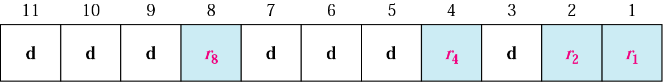
Hamming Code： Positions of Redundancy Bits 校验码的位置
在采用海明码的一串数据中，2的i次方的位置上，放校验码。
校验码是1，或者是0，使得校验码所在的组的1的个数是偶数。

Slide 38
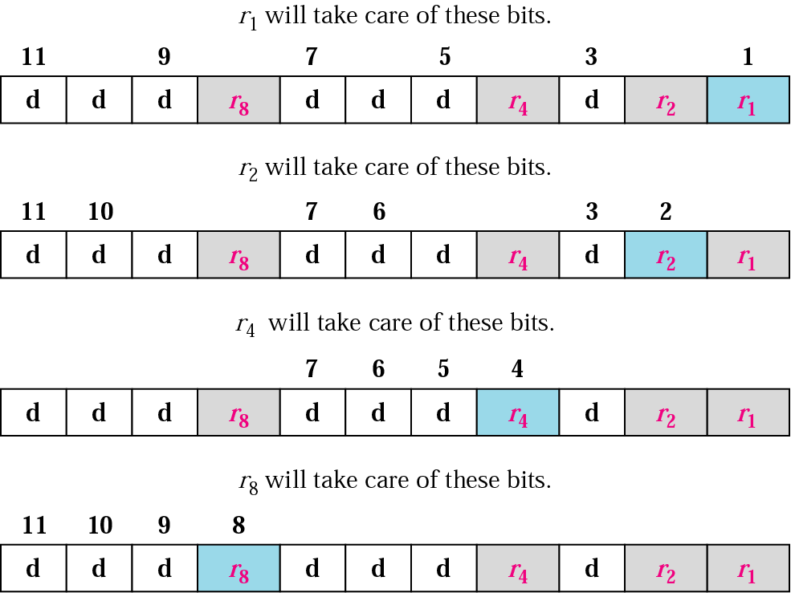
Redundancy Bits Calculation 分组原理
首先把表示位置的这个数，转化成二进制数。
比如，
第1个位置，变成第0001个位置；
第2个位置，变成第0010个位置；
第3个位置，变成第0011个位置；
第4个位置，变成第0100个位置；
第5个位置，变成第0101个位置；
第6个位置，变成第0110个位置；
…
凡是位置数符合这种形式的，XXX1，归到B1；
凡是位置数符合这种形式的，XX1X，归到B2；
凡是位置数符合这种形式的，X1XX，归到B3；
凡是位置数符合这种形式的，1XXX，归到B4；
这样各个校验码也被分到各个组里面去了，而且，每个组只有一个校验码。
组分好了，校验码的值也就确定下来了（确保组内偶数个1）。这样整个串的码就确定下来了。

Slide 39
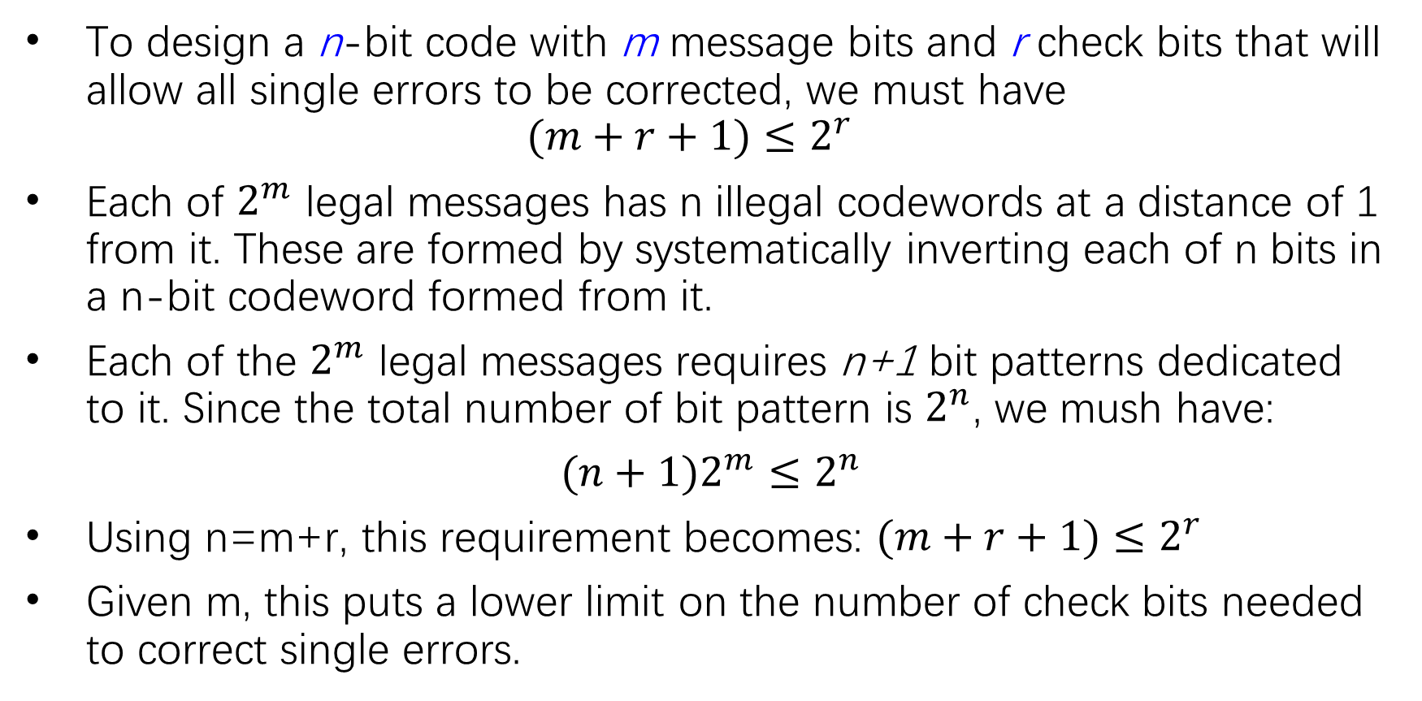
Single Error Correction
To design a n-bit code with m message bits and r check bits that will allow all single errors to be corrected, we must have
$$(m+r+1)≤2^{r}$$
Each of $2^{m}$ legal messages has n illegal codewords at a distance of 1 from it. These are formed by systematically inverting each of n bits in a n-bit codeword formed from it.
Each of the $2^{m}$ legal messages requires n+1 bit patterns dedicated to it. Since the total number of bit pattern is $2^{n}$, we mush have:
$(n+1)2^{m}≤2^{n}$
Using n=m+r, this requirement becomes: $(m+r+1)≤2^{r}$
Given m, this puts a lower limit on the number of check bits needed to correct single errors.

Slide 40
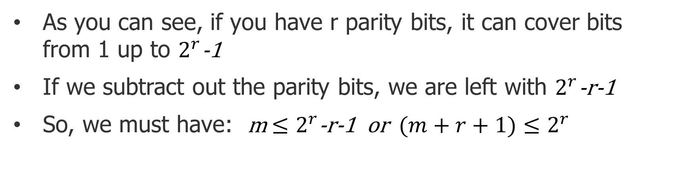
Single Error Correction – 从另一个角度来思考
As you can see, if you have r parity bits, it can cover bits from 1 up to $2^{r}$-1
If we subtract out the parity bits, we are left with $2^{r}$-r-1
So, we must have: m${ ≤2}^{r}$-r-1 or $(m+r+1)≤2^{r}$
首先我们考虑我们到底要发多少位。假设校验码一共r位，我们想发的原始数据一共m位，要注意我们的校验码也要校验校验码错没错，所以，要校验的一共有m+r位，r位校验码可以检测2^r-1位的码，所以，校验码的位数要满足这个公式 2^r -1 >= m+r
这样我们就能算出来要用多少校验码了。

Slide 41
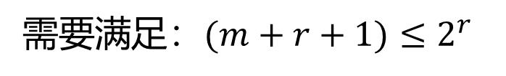
Data and redundancy bits of Hamming Codes
需要满足：$(m+r+1)≤2^{r}$
Number of data bits m | Number of redundancy bits r | Total bits m + r
1 | 2 | 3
2 | 3 | 5
3 | 3 | 6
4 | 3 | 7
5 | 4 | 9
6 | 4 | 10
7 | 4 | 11

Slide 42
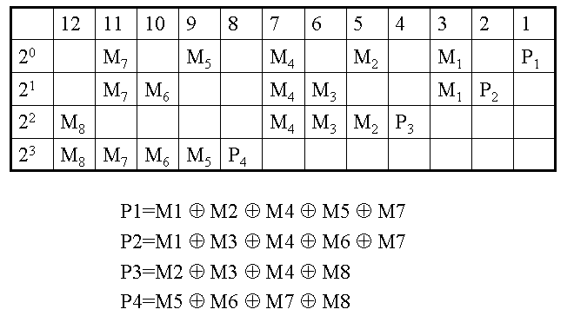
Hamming Code Example
Example
“H”=1001000
P₁=M₁⊕M₂ ⊕ M₄ ⊕ M₅ ⊕ M₇=1 ⊕ 0 ⊕ 1 ⊕ 0 ⊕ 0=0
P₂=M₁ ⊕ M₃ ⊕ M₄ ⊕ M₆ ⊕ M₇=1 ⊕ 0 ⊕ 1 ⊕ 0 ⊕ 0=0
P₃=M₂ ⊕ M₃ ⊕ M₄ ⊕ M₈=0 ⊕ 0 ⊕ 1 ⊕0 =1
P₄=M₅ ⊕ M₆ ⊕ M₇ ⊕ M₈=0 ⊕ 0 ⊕ 0 ⊕ 0=0
Codeword=00110010000

Slide 43
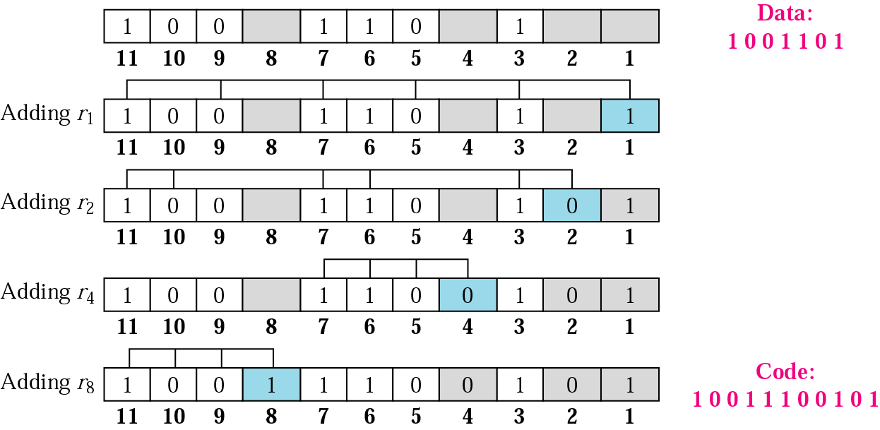
Example： Encoding
r1负责：1,3,5,7,9,11
r2负责：2,3,6,7,10,11
r4负责：4,5,6,7
r8负责：8,9,10,11

Slide 44
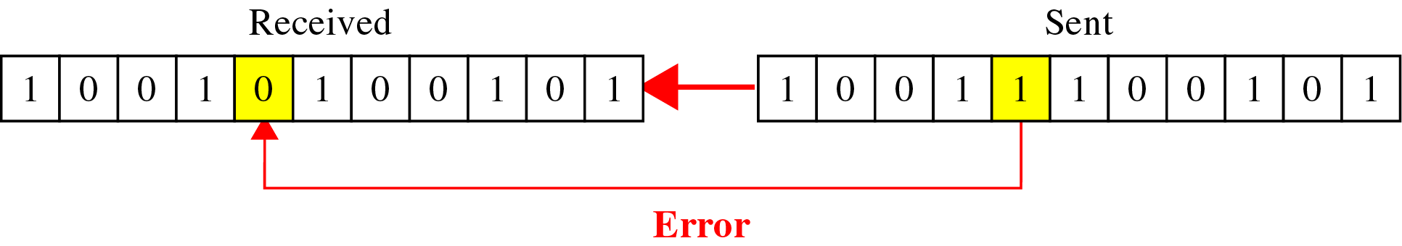
Example：Transmission
Error Happens...

Slide 45
1 | 0 | 1 | 0 |  | 0 | 1 | 0 |  | 1
12
11
10
9
8
7
6
5
4
3
2
1
Adding r1
1 | 0 | 1 | 0 |  | 0 | 1 | 0 |  | 1 |  | 1
12
11
10
9
8
7
6
5
4
3
2
1
Adding r2
1 | 0 | 1 | 0 |  | 0 | 1 | 0 |  | 1 | 1 | 1
12
11
10
9
8
7
6
5
4
3
2
1
Adding r3
1 | 0 | 1 | 0 |  | 0 | 1 | 0 | 0 | 1 | 1 | 1
12
11
10
9
8
7
6
5
4
3
2
1
Adding r4
1 | 0 | 1 | 0 | 0 | 0 | 1 | 0 | 0 | 1 | 1 | 1
12
11
10
9
8
7
6
5
4
3
2
1

Slide 46
corrupted
1 | 1 | 1 | 1 | 0 | 0 | 0 | 0 | 0 | 1 | 0 | 1
12
11
10
9
8
7
6
5
4
3
2
1
1 | 1 | 1 | 1 | 0 | 0 | 0 | 0 | 0 | 1 | 0 | 1
12
11
10
9
8
7
6
5
4
3
2
1
1 | 1 | 1 | 1 | 0 | 0 | 0 | 0 | 0 | 1 | 0 | 1
12
11
10
9
8
7
6
5
4
3
2
1
1 | 1 | 1 | 1 | 0 | 0 | 0 | 0 | 0 | 1 | 0 | 1
12
11
10
9
8
7
6
5
4
3
2
1
0 1 1 0
6

Slide 47
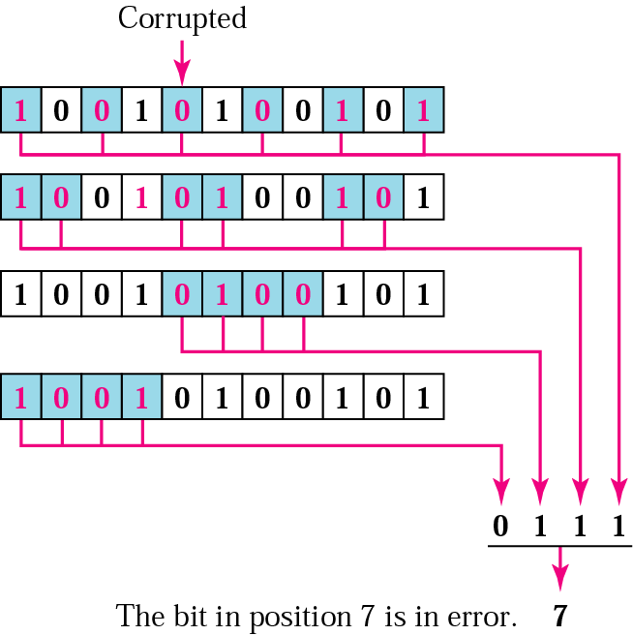
Example：Decoding & Error Correction using Hamming Code
把分组从大到小排列起来，奇偶校验标志数排成了一串01数据。这个数对应的十进制就是出错的数据的位置。如右图：
r8组标志0
r4组标志1
r2组标志1
r1组标志1
由高到低排列为：0111，对应十进制数7，即第7个位置是错误位
… | r8 标志位 | r4 标志位 | r2 标志位 | r1 标志位
0
1
1
1

Slide 48
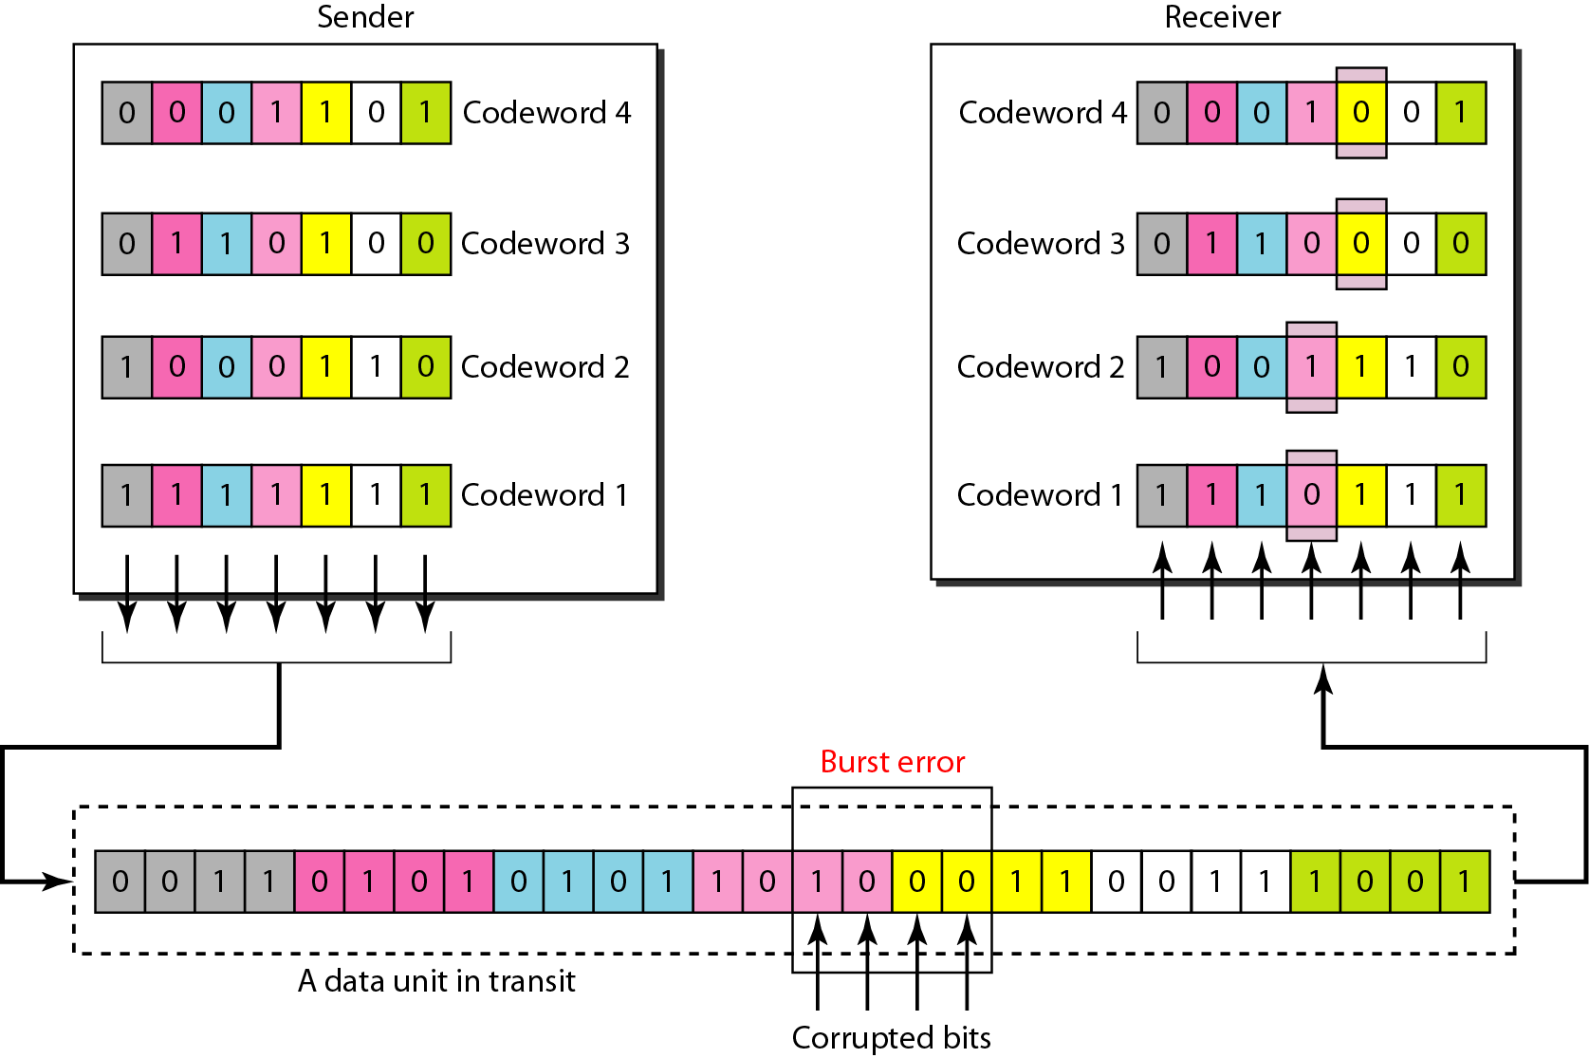
Burst error correction using Hamming code

Slide 49
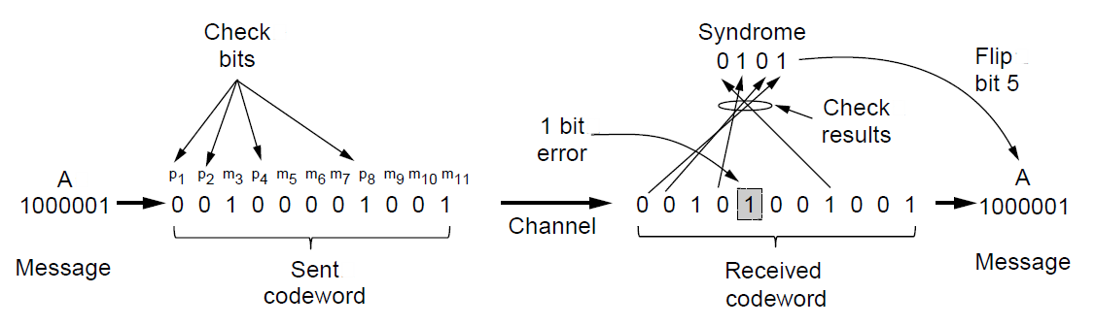
Summary of Hamming code
Hamming code gives a simple way to add check bits and correct up to a single bit error:
Check bits are parity over subsets of the codeword
Recomputing the parity sums (syndrome) gives the position of the error to flip, or 0 if there is no error
(11, 7) Hamming code adds 4 check bits and can correct 1 error

Slide 50
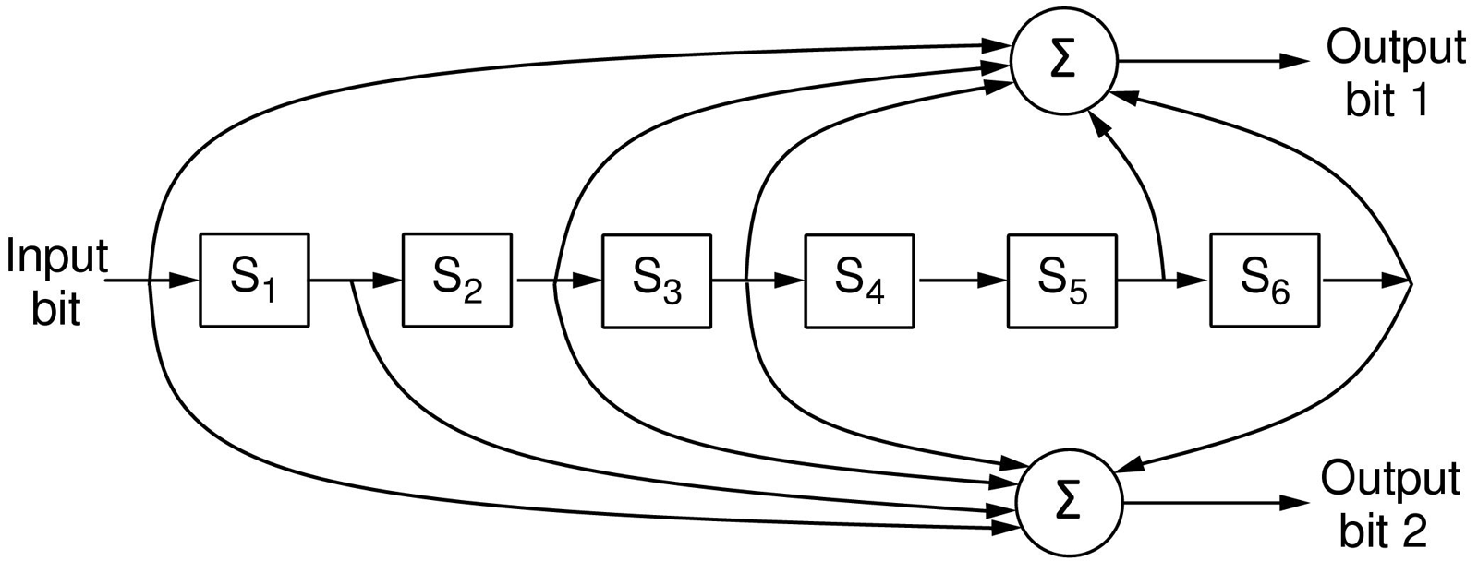
Error Correction – Convolutional codes
Operates on a stream of bits, keeping internal state
Output stream is a function of all preceding input bits
Bits are decoded with the Viterbi algorithm
Widely used in deployed networks, such as GSM, satellite communications, and 802.11
… 1 1 1
…
0 1 1
1 0 1
Popular NASA binary convolutional code (rate = ½) used in 802.11
In the above Fig., each input bit on the left-hand side produces two output bits on the right-hand side that are XOR sums of the input and internal state. Since it deals with bits and performs linear operations, this is a binary, linear convolutional code. Since 1 input bit produces 2 output bits, the code rate is 1/2.

Slide 51
Error detection codes
Parity »
Checksums »
Cyclic redundancy codes »

Slide 52
Error Detection – Parity (1)
Parity bit is added as the modulo 2 sum of data bits
Equivalent to XOR; this is even parity
Ex: 1110000 → 11100001
Detection checks if the sum is wrong (an error)
Simple way to detect an odd number of errors
Ex: 1 error, 11100101; detected, sum is wrong
Ex: 3 errors, 11011001; detected sum is wrong
Ex: 2 errors, 11101101; not detected, sum is right!
Error can also be in the parity bit itself
Random errors are detected with probability ½

Slide 53
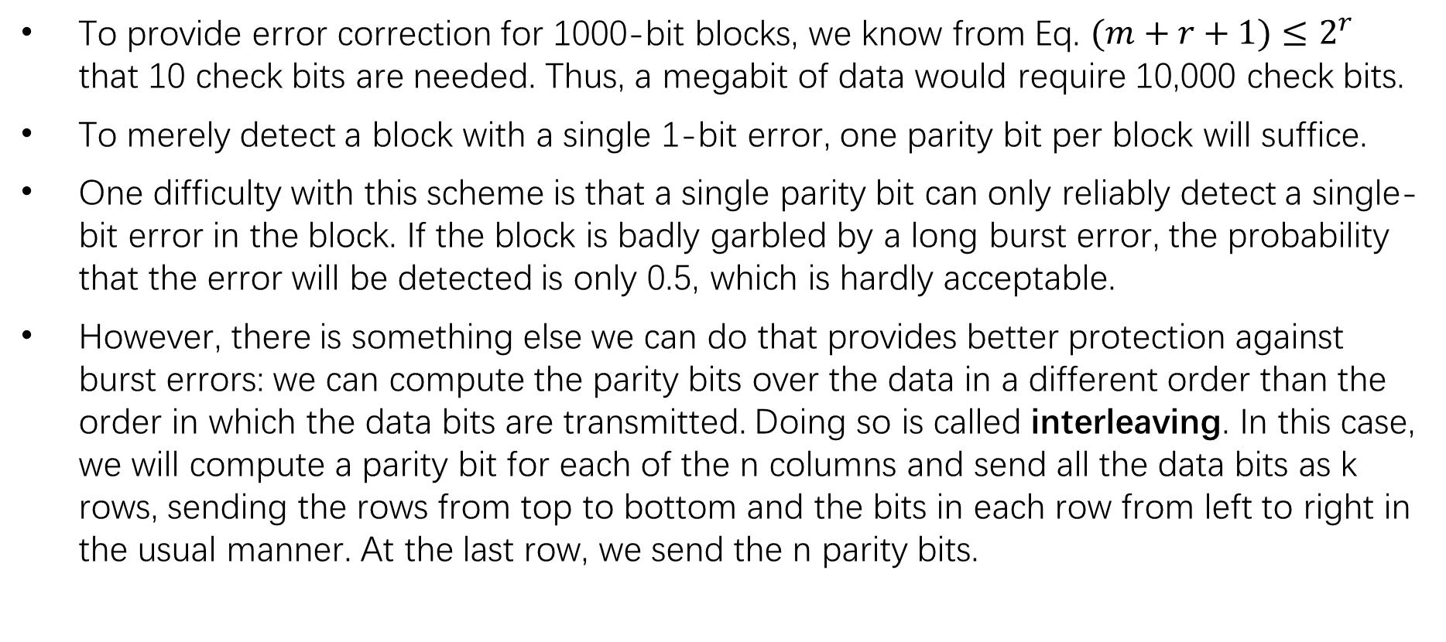
Error Detection – Parity (2)
To provide error correction for 1000-bit blocks, we know from Eq. $(m+r+1)≤2^{r}$ that 10 check bits are needed. Thus, a megabit of data would require 10,000 check bits.
To merely detect a block with a single 1-bit error, one parity bit per block will suffice.
One difficulty with this scheme is that a single parity bit can only reliably detect a single-bit error in the block. If the block is badly garbled by a long burst error, the probability that the error will be detected is only 0.5, which is hardly acceptable.
However, there is something else we can do that provides better protection against burst errors: we can compute the parity bits over the data in a different order than the order in which the data bits are transmitted. Doing so is called interleaving. In this case, we will compute a parity bit for each of the n columns and send all the data bits as k rows, sending the rows from top to bottom and the bits in each row from left to right in the usual manner. At the last row, we send the n parity bits.

Slide 54
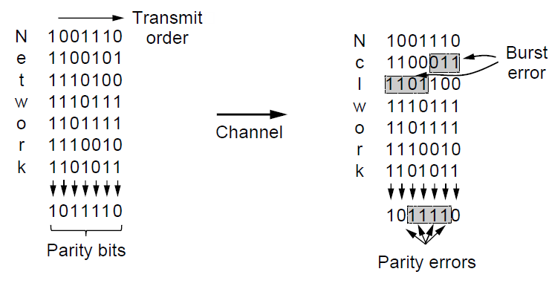
Error Detection – Parity (2)
Interleaving of N parity bits detects burst errors up to N
Each parity sum is made over non-adjacent bits
An even burst of up to N errors will not cause it to fail
This method uses n parity bits on blocks of kn data bits to detect a single burst error of length n or less.
A burst error does not imply that all the bits are wrong; it just implies that at least the first and last are wrong. In this figure, 4 bits are flipped over a range of 7 bits.

Slide 55
Error Detection – Checksums
Checksum is an error-detecting technique that can be applied to a message of any length.
Checksum treats data as N-bit words and adds N check bits that are the modulo 2^{N} sum of the words
Ex: Internet 16-bit one’s complement checksum
Properties:
Improved error detection over parity bits
Detects bursts up to N errors
Detects random errors with probability 1-2^{-N}
Vulnerable to systematic errors, e.g., added zeros

Slide 56
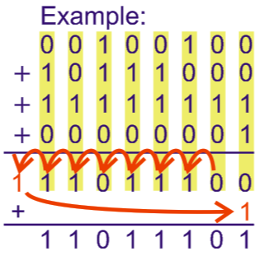
one‘s complement: 带循环进位(end round carry)的加法，最高位有进位应循环进到最低位。

Slide 57
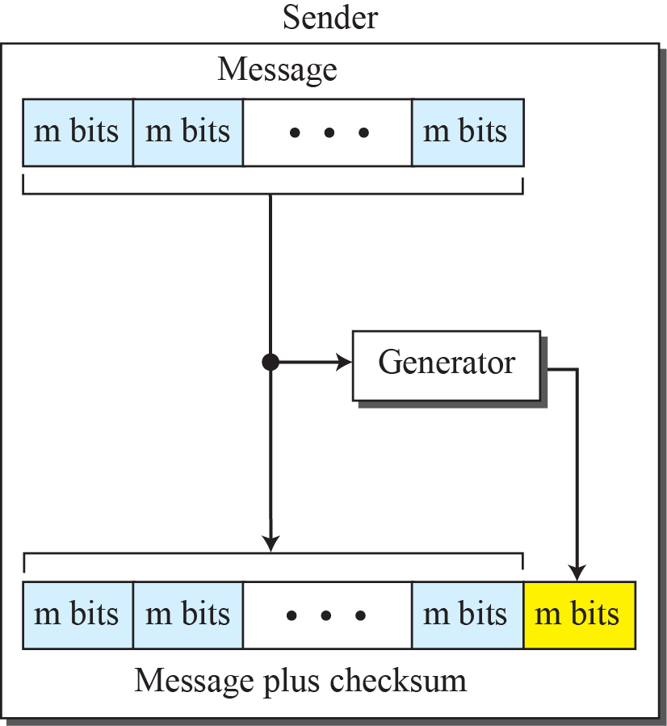
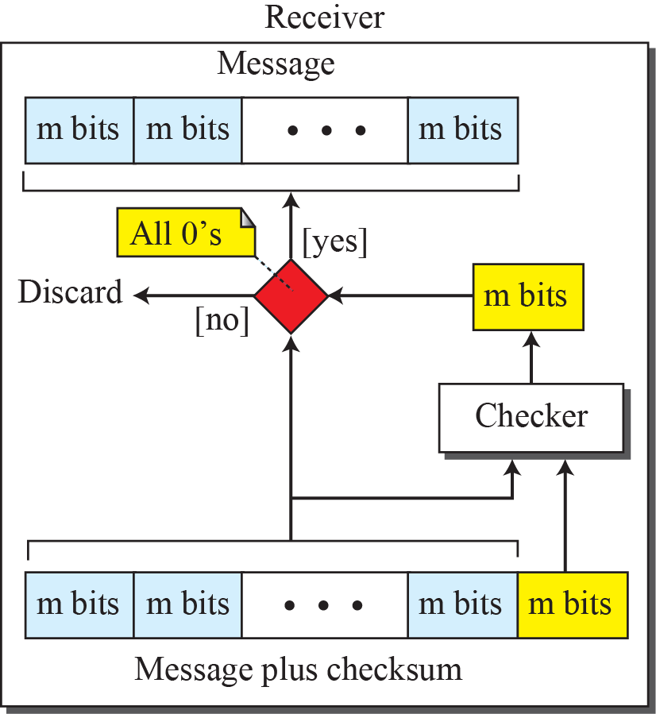
Checksum
CheckSum生成：将发送数据逐个累加（若干16位的位串）进行one’s complement sum运算，再对累加和取反，该值即为CheckSum校验码。
CheckSum校验：将接收到的数据与校验码连续累加进行one’s complement sum运算，累加的结果再取反码。若取反后的值为0，则表示校验正确，数据有效；否则，校验错误，数据无效。

Slide 58
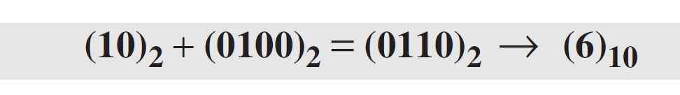
Checksum Example
Suppose the message is a list of five 4-bit numbers that we want to send to a destination. In addition to sending these numbers, we send the sum of the numbers.
For example, if the set of numbers is (7, 11, 12, 0, 6), we send (7, 11, 12, 0, 6, 36), where 36 is the sum of the original numbers.
The decimal number 36 in binary is (100100)2. To change it to a 4-bit number we add the extra leftmost bit to the right four bits as shown below.

Slide 59
Checksum Example (cont.)
The sender adds all five numbers in one’s complement to get the sum = 6. The sender then complements the result to get the checksum = 9, which is 15 − 6.
Note that 6 = (0110)2 and 9 = (1001)2; they are complements of each other.
The sender sends the five data numbers and the checksum (7, 11, 12, 0, 6, 9).
If there is no corruption in transmission, the receiver receives (7, 11, 12, 0, 6, 9) and adds them in one’s complement to get 15.

Slide 60
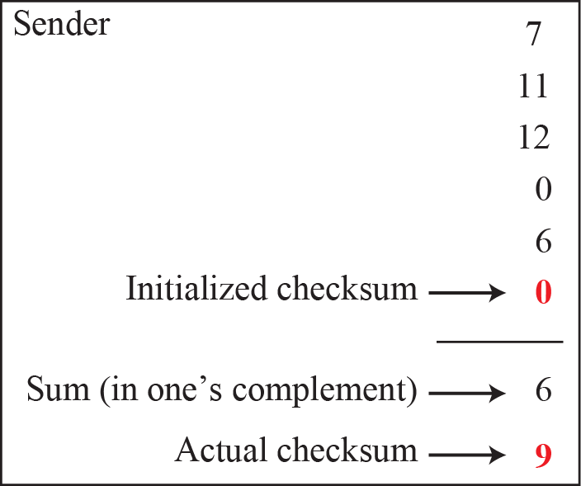
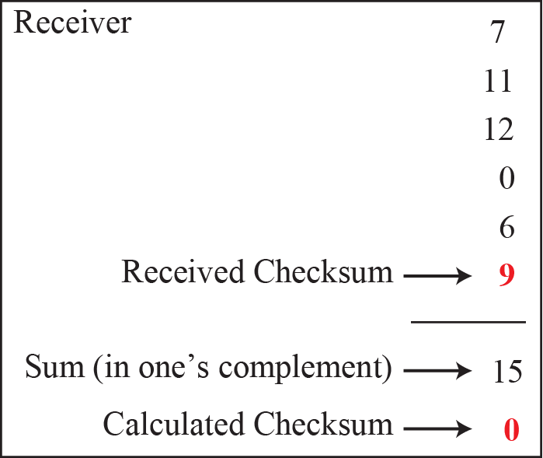
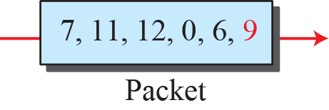
Calculation procedure of the previous example
1111
0000

Slide 61
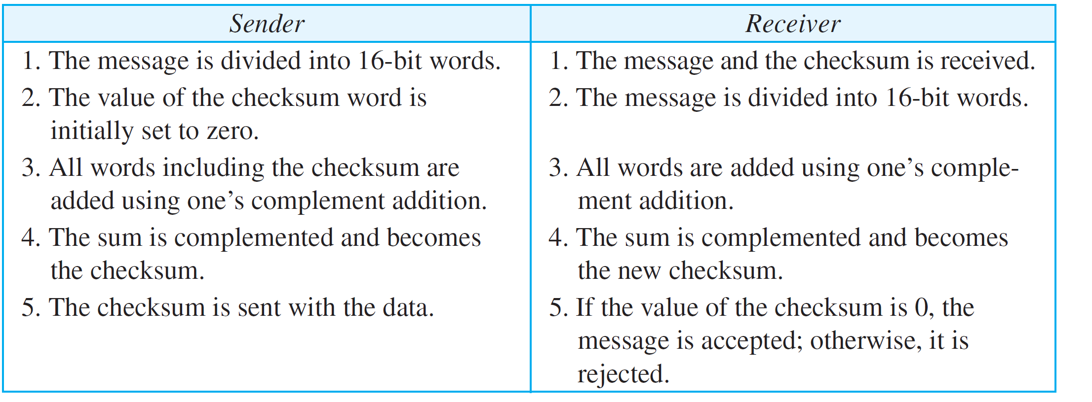
Procedure to calculate the traditional checksum

Slide 62
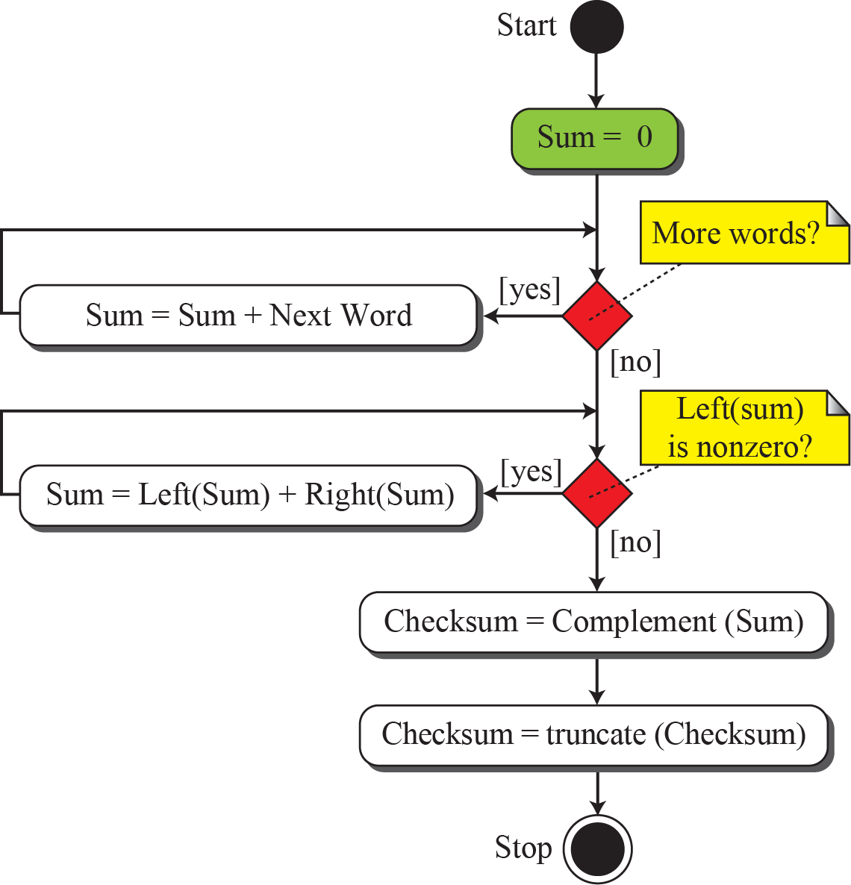
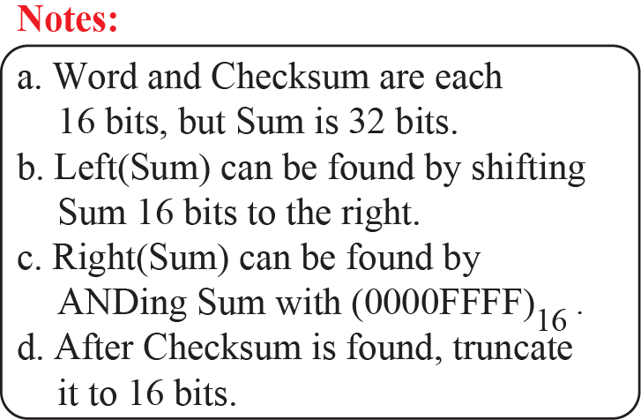
Algorithm to calculate the traditional checksum

Slide 63
Problems of the traditional checksum calculation
If two 16-bit items are transposed（调换/换位） in transmission, the checksum cannot catch this error.
The reason is that the traditional checksum is not weighted: it treats each data item equally.
In other words, the order of data items is immaterial to the calculation.
Several approaches have been used to prevent this problem, such as Fletcher and Adler.

Slide 64
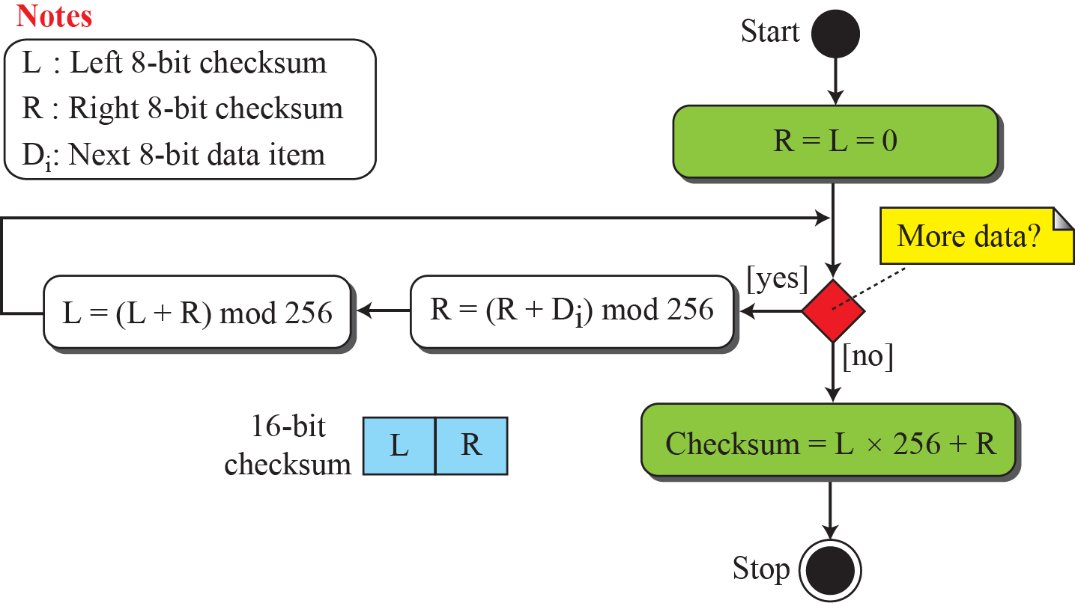
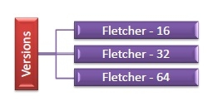
Algorithm to calculate an 8-bit Fletcher checksum
For fair comparison, each running sum is half width E.g., 16-bit Fletcher Checksum is two 8-bit running sums.
Use two running one’s complement checksums
Makes checksum order-dependent (switched byte order detected)
Fletcher checksum有三种不同的算法参数：
Fletcher-16 (8bit + 8bit)
Fletcher-32 (16bit + 16bit)
Fletcher-64 (32bit + 32bit)
The modulus selected:
Fletcher-16: 255
Fletcher-32: 65535
Fleccher-64: 4,294,967,295
255
255
Notes:
2进制8个1对应十进制255
乘以256相当于左移8位

Slide 65

Algorithm to calculate an Adler checksum
The Adler-32 checksum is a specialization of the Fletcher-32 checksum devised by Mark Adler
旨在改进 Fletcher Checksum。Adler校验和使用素数作为模数，比如251（Fletcher 255）， 65521（Fletcher 65535）

Slide 66
Cyclic codes循环码
Cyclic codes are special linear block codes with one extra property.
In a cyclic code, if a codeword is cyclically shifted (rotated), the result is another codeword.
For example, if 1011000 is a codeword and we cyclically left-shift, then 0110001 is also a codeword.
Cyclic Redundancy Check (CRC), which is used in networks such as LANs and WANs. It adds bits so that transmitted frame viewed as a polynomial is evenly divisible (整除) by a generator polynomial.

Slide 67

CRC Basics：A polynomial to represent a binary word
CRC 基于循环纠错码理论，是基于伽罗华域(Galois Field) GF(2)（即除以 2 的同余）的多项式环。
在代数编码理论中，将一个码组表示为一个多项式，码组中各码元当作多项式的系数。任意一个由二进制位串组成的代码都可以和一个系数仅为 ‘0’ 和 ‘1’ 取值的多项式一一对应。如下图。
x⁶+x+1多项式对应的代码为1000011

Slide 68
CRC Calculation
校验码的生成过程：假设要发送的信息用多项式 C(x) 表示，将 C(x) 左移 R 位（可表示成 C(x) << R），这样 C(x) 的右边就会空出 R 位，这就是校验码的位置。用 C(x) << R除以 G(x) 得到的余数就是校验码。
G(x)： 表示 CRC 的生成多项式，是接收方和发送方的一个约定，由 CRC 规范给定。在整个传输过程中，这个二进制数始终保持不变。例如 CRC-CCITT 的生成多项式为 G(x) = x¹⁶ + x¹² + x⁵ + 1。
C(x)： 表示发送的原始数据的多项式。例如 C(x) = x⁵ + x³ + x² + x + 1 表示发送的数据为 101111
R(x)： 表示CRC 码的多项式。R(x) = (C(x) << R) % G(x)
T(x)： 表示发送的原始数据加上 CRC 码之后的多项式。T(x) = C(x) << R + R(x)
K：发送数据的长度。其等于 C(x) 中的最高次的幂 + 1。如上例子的 C(x) 中，K = 5 + 1 = 6
R： CRC 码 的长度。CRC校验码位数 = 生成多项式G(x)位数 - 1。
1101010110
商（CRC不用）
G(x)除数
110101
101000110100000
被除数C(x)<<R
左移R位，补位0
01110
原始数据C(x)
CRC码R(x)
实际需要发送的数据是101000110101110。需要注意的是，余数（R(x)）不足 R 位时，高位补 0！
Notes:
CRC分为以下几种标准：
CRC-12码
CRC-16码
CRC-CCITT码
CRC-32码
CCITT国际电报电话咨询委员会，是国际电信咨询机构，简称CCITT,总部设在瑞士日内瓦

Slide 69

CRC Calculation
生成多项式G(x)应满足以下条件：
生成多项式的最高位和最低位必须为 1
当被传送信息（CRC码）任何一位发生错误时，被生成多项式做除后应该使余数不为 0
不同位发生错误时，应该使余数不同
对余数继续做除，应使余数循环
在 K 位信息码后再拼接 R 位的校验码，整个编码长度为 N 位。因此，这种编码也叫 ( N，K ) 码。对于一个给定的 ( N，K ) 码，可以证明存在一个最高次幂为 N - K = R 的多项式 G(x)。根据 G(x) 可以生成 K 位信息的校验码，而 G(x) 叫做这个 CRC 码的生成多项式。

Slide 70

Error Detection – CRCs
Start by adding 0s to frame and try dividing
Offset by any reminder to make it evenly divisible

Slide 71



Division in CRC encoder

Slide 72


Division in the CRC decoder for two cases

Slide 73

CRC division using polynomials

Slide 74
Synchronous Transfer Mode

Slide 75
Performance
In a cyclic code, those e(x) errors that are divisible by g(x) are not caught.
If the generator has more than one term and the coefficient of x⁰ is 1, all single errors can be caught.
A generator that contains a factor of x + 1 can detect all odd-numbered errors.
Notes:
能被g(x)整除的error e(x)是检测不出来的，只有当除g(x)余数不为0时才能判断错误的存在。

Slide 76
Performance (contd.)
All burst errors with L ≤ r will be detected. With r check bits.
All burst errors with L = r + 1 will be detected with probability 1 – (1/2)^{r–1}.
All burst errors with L > r + 1 will be detected with probability 1 – (1/2)^{r}.

Slide 77
Properties of Good Polynomials
A good polynomial generator needs to have the following characteristics:
It should have at least two terms.
The coefficient of the term x⁰ should be 1.
It should have the factor x + 1.

Slide 78
CRC: a good candidate for many networks
Based on standard polynomials:
Ex: Ethernet 32-bit CRC is defined by:
Computed with simple shift/XOR circuits
CRC-12: x¹²+x¹¹+x³+x²+x¹+1
CRC-16: x¹⁶+x¹⁵+x²+1
CRC-CCITT:x¹⁶+x¹²+x⁵+1
Stronger detection than checksums:
Catch all errors with odd number of inverted bits (by x+1 factor)
Not vulnerable to systematic errors
A polynomial code with r check bits will detect all burst errors of length <= r.

Slide 79
Chapter3：The Data Link Layer
Data Link Layer Design Issues 》数据链路层设计要素
Error Detection and Correction 》检错与纠错
Elementary Data Link Protocols 》基本的数据链路协议
Sliding Window Protocols 》滑动窗口协议
Example Data Link Protocols 》数据链路协议实例

Slide 80
Elementary Data Link Protocols
Link layer environment »
Utopian Simplex Protocol »
Stop-and-Wait Protocol for Error-free channel »
Stop-and-Wait Protocol for Noisy channel »

Slide 81

Link layer environment (1)
Commonly implemented as NICs and OS drivers; network layer (IP) is often OS software
Notes:
we assume that the physical layer, data link layer, and network layer are independent processes that communicate by passing messages back and forth. A common implementation is shown in Fig. 3-10. The physical layer process and some of the data link layer process run on dedicate hardware called a NIC (Network Interface Card). The rest of the link layer process and the network layer process run on the main CPU as part of the operating system, with the software for the link layer process often taking the form of a device driver. However, other implementations are also possible (e.g., three processes offloaded to dedicated hardware called a network accelerator)

Slide 82
Link layer environment (2)
Link layer protocol implementations use library functions
See code (protocol.h) for more details
Group | Library Function | Description
Network layer | from_network_layer(&packet) to_network_layer(&packet) enable_network_layer() disable_network_layer() | Take a packet from network layer to send Deliver a received packet to network layer Let network cause “ready” events Prevent network “ready” events
Physical layer | from_physical_layer(&frame) to_physical_layer(&frame) | Get an incoming frame from physical layer Pass an outgoing frame to physical layer
Events & timers | wait_for_event(&event) start_timer(seq_nr) stop_timer(seq_nr) start_ack_timer() stop_ack_timer() | Wait for a packet / frame / timer event Start a countdown timer running Stop a countdown timer from running Start the ACK countdown timer Stop the ACK countdown timer

Slide 83

Link layer environment (3)
协议中需要遵循一些定义
在文件protocol.h中定义

Slide 84
Link layer environment (4)

Slide 85


Utopian Simplex Protocol 乌托邦单纯形协议 (1)
An optimistic protocol (p1) to get us started
Assumes no errors, and receiver as fast as sender
Considers one-way data transfer
That’s it, no error or flow control …
This is essentially what Ethernet does – just blast packets and receive as quickly as possible
}
Sender loops blasting frames
Receiver loops eating frames

Slide 86




Utopian Simplex Protocol 乌托邦单纯形协议 (2)

Slide 87


Stop-and-Wait – Error-free channel
Protocol (p2) ensures sender can’t outpace receiver:
Receiver returns a dummy frame (ack) when ready
Only one frame out at a time – called stop-and-wait
We added flow control!
注意：receiver发送的该ACK确认的是允许sender可以发送下一个frame，而非确认的是收到的frame是正确的。
只有流控，没有错误控制
Sender waits for ack after passing frame to physical layer
Receiver sends ack after passing frame to network layer

Slide 88

Stop-and-Wait – Noisy channel (1)
Unreliable Physical line
Solution
Sender sends frame with CRC, and sets timer,
Receiver verifies CRC value and sends ACK or NAK,
Sender sends a new frame when receives an ACK, sends old frame when receives an NAK or timeout.
ARQ (Automatic Repeat reQuest自动重复请求) adds error control
ARQ is also called PAR (Positive Acknowledgement with Retransmission)
Receiver acks frames that are correctly delivered
Sender sets timer and resends frame if no ack)
For correctness, frames and acks must be numbered
Else receiver can’t tell retransmission (due to lost ack or early timer) from new frame
For stop-and-wait, 2 numbers (1 bit) are sufficient

Slide 89

Stop-and-Wait – Noisy channel (2)

Slide 90



Stop-and-Wait – Noisy channel (3)
The 1st frame is sent and acknowledged.
The 2nd frame is sent, but lost. After time-out, it is resent.
The 3rd frame is sent and ACKed, but the ACK is lost. The frame is resent.
How to correct this problem?
Using sequence numbers and acknowledgment numbers.
Is there any problem here?
It is not right for the network layer at the receiver site receives two copies of the 3rd frame.

Slide 91




Stop-and-Wait – Noisy channel (4)
Adding sequence numbers and acknowledgment numbers to prevent duplicates.
The 1st frame is sent and acknowledged.
The 2nd frame is sent, but lost. After time-out, it is resent.
The 3rd frame is sent and ACKed, but the ACK is lost. The frame is resent.

Slide 92


Stop-and-Wait – Noisy channel (5)
Sender loop (p3):
This is essentially what 802.11 does – stop-and-wait to handle wireless errors. 802.11 uses a larger sequence number (12 bits) and gives up after a limited number of retransmissions (retries).
{
Send frame (or retransmission)
Set timer for retransmission
Wait for ack or timeout
If a good ack then set up for the next frame to send (else the old frame will be retransmitted)

Slide 93

Stop-and-Wait – Noisy channel (6)
Receiver loop (p3):
Wait for a frame
If it’s new then take it and advance expected frame
Ack current frame

Slide 94


Slide 95
A positive acknowledgement with retransmission protocol.

Slide 96

Stop-and-Wait
Problem: Keeping the pipe full.
Example: 1.5Mbps link X 45ms RTT = 每秒传输67.5Kb (8.4KB).
Assuming frame size of 1KB, stop-and-wait uses about one-eighth of the link’s capacity.
Want the sender to be able to transmit up to 8 frames before having to wait for an ACK.

Slide 97

Sliding Window
Idea: Allow sender to transmit multiple frames before receiving an ACK, thereby keeping the pipe full.
There is an upper limit on the number of outstanding (un-ACKed) frames allowed.

Slide 98
Chapter3：The Data Link Layer
Data Link Layer Design Issues 》数据链路层设计要素
Error Detection and Correction 》检错与纠错
Elementary Data Link Protocols 》基本的数据链路协议
Sliding Window Protocols 》滑动窗口协议
Example Data Link Protocols 》数据链路协议实例

Slide 99
Sliding Window Protocols
Sliding Window concept »
One-bit Sliding Window »
Go-Back-N »
Selective Repeat »

Slide 100
Sliding Window concept (1)
In the previous protocols, data frames were transmitted in one direction only
In practice: there is a need to transmit data in both directions
Piggybacking （捎带确认）
When a data frame arrives, instead of immediately sending a separate ACK, the receiver restrains itself and waits until the network layer passes it the next packet. The ACK is attached to the outgoing data frame. The technique of temporarily delaying outgoing acknowledgements so that they can be hooked onto the next outgoing data frame is known as piggybacking.
Problem: If the data link layer waits longer than the sender’s timeout period, the frame will be retransmitted, defeating the whole purpose of having acknowledgements.
Sliding window
Sequence number
Window Size
Upper edge and Lower edge

Slide 101
Sliding Window concept (2)
Object：more efficient
Sender maintains window of frames it can send
Needs to buffer them for possible retransmission
Window advances with next acknowledgements
Receiver maintains window of frames it can receive
Needs to keep buffer space for arrivals
Window advances with in-order arrivals

Slide 102




Sliding window in circular format
A sliding window of size 7, with 4-bit sequence number

Slide 103




Sliding window in linear format

Slide 104


Sliding Window Example
A sliding window advancing at the sender and receiver
Ex: window size is 1, with a 3-bit sequence number.
Sender maintains window of frames it can send
Needs to buffer them for possible retransmission
Window advances with next acknowledgements
Receiver maintains window of frames it can receive
Needs to keep buffer space for arrivals
Window advances with in-order arrivals
Sender
Receiver
At the start
First frame is sent
First frame is received
Sender gets first ack

Slide 105
Pipelining
Larger windows enable pipelining for efficient link use
Stop-and-wait (w=1) is inefficient for long links
Best window (w) depends on bandwidth-delay
Here bandwidth is in bits/sec.
Delay is the one-way transit time.
Assume BD = bandwidth*delay/frame length, denoting the number of frames.
Then w should be set to be w ≥ 2BD+1 to ensure high link utilization
Twice the BD is the number of frames that sender can continuously send when the round-trip time to receive an ACK is considered.
The “+1” is because an ACK frame will not be sent until after a complete frame is received.
Notice: BD here is in the number of frames
If we use BDP directly, suppose L is the length of a frame, the formula should be
w ≥ 2BDP/L+1
Pipelining leads to different choices for errors/buffering
We will consider Go-Back-N and Selective Repeat

Slide 106
Pipelining Example
E.g.: For a link with a bandwidth of 50kbps and a one-way transmit time of 250msec, the bandwidth-delay product is 12.5 kbits or 12.5 frames of 1000bits each.
2BD+1 = 2 * 12.5 + 1 = 26 frames
At t = 0 ms, the sender begins sending frame 0 and sends a new frame every 20 msec (1000bits/50kbps=20msec).
At t = 520 ms, it has finished sending 26 frames, and the acknowledgement for frame 0 will have just arrived.
Thereafter, acknowledgements will arrive every 20 msec, so the sender will always get permission to continue just when it needs it.
From then onwards, 25 or 26 unacknowledged frames will always be outstanding. Put in other terms, the sender’s maximum window size is 26.

Slide 107
Sliding Window Protocols
Sliding Window concept »
One-bit Sliding Window »
Go-Back-N »
Selective Repeat »

Slide 108
One-Bit Sliding Window (1)
The sequence numbers are based on modulo-2 arithmetic.
Window size is 1.
Transfers data in both directions with stop-and-wait
Piggybacks acks on reverse data frames for efficiency
Handles transmission errors, flow control, early timers

Slide 109

One-Bit Sliding Window (2)
Each node is sender and receiver (p4):
Prepare first frame
Launch it, and set timer

Slide 110
One-Bit Sliding Window (3)
Wait for frame or timeout
If a frame with new data then deliver it
If an ack for last send then prepare for next data frame
(Otherwise it was a timeout)
Send next data frame or retransmit old one; ack the last data we received

Slide 111

One-Bit Sliding Window (4)
Two scenarios show subtle interactions exist in p4:
Simultaneous start [right] causes correct but slow operation compared to normal [left] due to duplicate transmissions.
Two scenarios for protocol 4. (a) Normal case. (b) Abnormal case.
The notation is (seq, ack, packet number). An asterisk indicates where a network layer accepts a packet.

Slide 112
Sliding Window Protocols
Sliding Window concept »
One-bit Sliding Window »
Go-Back-N »
Selective Repeat »

Slide 113

Go-Back-N (1)
Receiver only accepts/acks frames that arrive in order:
Discards frames that follow a missing/errored frame
Sender times out and resends all outstanding frames
Receiver’s window size is always 1. Ack for frame n means n - 1, n - 2, and so on are also acknowledged.
Piggyback
This approach can waste a lot of bandwidth if the error rate is high.

Slide 114
Go-Back-N (2)
The size of the sending window must be < MAX_SEQ +1 or <= MAX_SEQ (2^{m}-1);
Packet seq. number: (0, 1, …, MAX_SEQ). There are MAX_SEQ +1 distinct seq. numbers.
No more than MAX_SEQ unacknowledged frames outstanding at any time (i.e. the sender may transmit up to MAX_SEQ frames without waiting for an ACK), even though there are MAX_SEQ +1 distinct seq. numbers. To see why, consider the scenario with MAX_SEQ = 7:
The sender sends frames 0 through 7.
A piggybacked acknowledgement for 7 comes back to the sender.
The sender sends another eight frames, again with sequence numbers 0 through 7.
Now another piggybacked acknowledgement for frame 7 comes in.
The question is this: did all eight frames belonging to the second batch arrive successfully, or did all eight get lost? In both cases the receiver would be sending frame 7 as the acknowledgement. The sender has no way of telling. For this reason the maximum number of out-standing frames must be restricted to MAX SEQ.

Slide 115

Go-Back-N (3)
Tradeoff made for Go-Back-N:
Simple strategy for receiver; needs only 1 frame
Wastes link bandwidth for errors with large windows; entire window is retransmitted

Slide 116

Send window for Go-Back-N
The send window is an abstract concept defining an imaginary box of size 2^{m} − 1 with three variables: S_{f}, S_{n}, and S_{size}.
The send window can slide one or more slots when a valid acknowledgment arrives.

Slide 117

Receive window for Go-Back-N
The receive window is an abstract concept defining an imaginary box of size 1 with one single variable R_{n}.
The window slides when a correct frame has arrived; sliding occurs one slot at a time.

Slide 118

Send Window size for Go-Back-N

Slide 119

Cumulative Acknowledgment
Although ACK 2 is lost, ACK 3 serves as both ACK 2 and ACK 3.

Slide 120

What happens when a frame is lost in Go-Back-N?
The receiver receives frames 2 and 3, but they are discarded because they are received out of order.

Slide 121

Sliding Window Protocol Using Go Back N

Slide 123


Slide 125
Sliding Window Protocols
Sliding Window concept »
One-bit Sliding Window »
Go-Back-N »
Selective Repeat »

Slide 126

Selective Repeat (1)
Receiver accepts frames anywhere in receive window
Cumulative ack indicates highest in-order frame
NAK (negative ack) causes sender retransmission of a missing frame before a timeout resends window

Slide 127
Selective Repeat (2)
In Selective Repeat, the size of the sender and receiver window must be at most 2^{m-1} or (MAX_SEQ+1)/2
S sends 0,1,2,3,4,5,6
R accepted and sends ACK0,1,2,3,4,5,6,but lost
S resend 0
R sends ACK6 (new 0 received, but no 7)
S sends 7 (0 to 6 received, so 7)
R accepts 7 and 0(the old one as new one)
S sends new 0, rejected by R
Piggyback or independent to send ACK
Send NAK immediately when a error may happened
Bandwidth efficiency is higher
Buffer space is larger

Slide 128

Selective Repeat (3)
For correctness, we require:
Sequence numbers (s) at least twice the window (w)
Error case (s=8, w=7) – too few sequence numbers
Correct (s=8, w=4) – enough sequence numbers
Originals
Retransmits
Originals
Retransmits
New receive window overlaps old – retransmits ambiguous
New and old receive window don’t overlap – no ambiguity
Computer Networks, Chapter 3 The Data Link Layer

Slide 129
Selective Repeat (4)
Some parameters
Ack_Received
Ack_Expected /*lower edge of sender’s window*/
Next_Fram_To_Send /*upper edge of sender’s window + 1*/
Frame_Expected /*lower edge of receiver’s window*/
Too_far /*upper edge of receiver’s window + 1*/

Slide 130
Selective Repeat (3)
Tradeoff made for Selective Repeat:
More complex than Go-Back-N due to buffering at receiver and multiple timers at sender
More efficient use of link bandwidth as only lost frames are resent (with low error rates)
Implemented as p6 (see code in book)

Slide 131


Send and receive window for Selective Repeat

Slide 132

Window size for Selective Repeat

Slide 133

What happens when a frame is lost in Selective Repeat?
The timers need to be numbered.
A NAK is sent once for each window position.
Cumulative acknowledgment

Slide 134

A Sliding Window Protocol Using Selective Repeat

Slide 136


Slide 138
Channel utilization analysis -- Non-Pipelining
sender
receiver
first packet bit transmitted, t = 0
last packet bit transmitted, t = l / b
first packet bit arrives
R
last packet bit arrives, send ACK
ACK arrives, send next
packet, t = R + l / b
line utilization = (l/b) / (R + l / b) = l / (l+bR)

Slide 139
Pipelining: increased utilization
sender
receiver
first packet bit transmitted, t = 0
Increase utilization
by a factor of 3!
last bit transmitted, t = l / b
first packet bit arrives
R
last packet bit arrives, send ACK
last bit of 2nd packet arrives, send ACK
last bit of 3rd packet arrives, send ACK
ACK arrives, send next
packet, t = R + l / b
line utilization = (3l/b) / (R + l / b) = 3l / (l+bR)

Slide 140
Channel Utilization with Ack Piggybacking
sender
receiver
first packet bit transmitted, t = 0
last packet bit transmitted, t = l / b
first packet bit arrives
R
last packet bit arrives, send ACK
ack-bearing frame transmitted
ACK arrives, send next
packet, t = R + 2l / b
line utilization = (l/b) / (R + 2l / b) = l / (2l+bR)

Slide 141
Pipelining and Ack Piggybacking
sender
receiver
first packet bit transmitted, t = 0
Still increase utilization
by a factor of 3!
last bit transmitted, t = l / b
first packet bit arrives
R
last packet bit arrives, sending ACK1
last bit of 2nd packet arrives, ACK1 done..
last bit of 3rd packet arrives, ACK2 done..
ACK arrives, send next
packet, t = R + 2l / b
line utilization = (3l/b) / (R + 2l / b) = 3l / (2l+bR)

Slide 142

Pipelined protocols
Pipelining: sender allows multiple, “in-flight”, yet-to-be-acknowledged pkts
range of sequence numbers must be increased
buffering at sender and/or receiver

Slide 143
Chapter3：The Data Link Layer
Data Link Layer Design Issues 》数据链路层设计要素
Error Detection and Correction 》检错与纠错
Elementary Data Link Protocols 》基本的数据链路协议
Sliding Window Protocols 》滑动窗口协议
Example Data Link Protocols 》数据链路协议实例

Slide 144
Example Data Link Protocols
HDLC (High-level Data Link Control )
Packet over SONET »
PPP (Point-to-Point Protocol) »
ADSL (Asymmetric Digital Subscriber Loop) »
Notes:
ADSL非对称数字用户线

Slide 145
HDLC
High-level Data Link Control (HDLC, 高级数据链路控制) is a bit-oriented protocol for communication over point-to-point and multipoint links.
Although HDLC is more a theoretical issue than practical, most of the concept defined in HDLC is the basis for other practical protocols such as PPP, Ethernet, or wireless LANs.
HDLC provides two common transfer modes that can be used in different configurations: normal response mode (NRM) and asynchronous balanced mode (ABM).

Slide 146




Normal Response Mode
正常响应方式NRM（Normal Response Mode）是一种非平衡正常响应方式。
该操作方式使用于面向终端的点到点或一点到多点的链路。在这种操作方式下，传输过程由主节点启动，从节点只有收到主节点某个命令帧后，才能作为响应向主节点传输信息。响应信息可以由一个或多个帧组成，若信息由多个帧组成，则应指出哪一帧是最后一帧。主节点负责管理整个链路，且具有轮询、选择从节点及向从节点发送命令的权利，同时也负责对超时、重发及各类恢复操作的控制。
在点-多点链路中，往往有一个站为控制站/主站，主管数据链路的信息流，并处理链路上出现的不可恢复的差错情况，其余各站则为受控站/从站。

Slide 147



Asynchronous Balanced Mode
异步平衡方式ABM（Asynchronous Balanced Mode）是一种允许任何节点来启动传输的操作方式。为了提高链路传输效率，节点之间在两个方向上都需要有较高的信息传输量。在这种操作方式下，任何时候任何节点都能启动传输操作，每个节点既可以作为主节点又可以作为从节点，即每个节点都是复合节点。各个节点都有相同的一组协议，任何节点都可以发送或接受命令，也可以给出应答，并且各节点对差错恢复过程都负有相同的责任。

Slide 148

Frame format for bit-oriented protocols.
数据链路控制规程，根据帧控制的格式，可以分为面向字符型、面向比特型。
面向字符型 在这类规程中，用字符编码集中的几个特定字符来控制链路的操作，监视链路的工作状态，例如，采用国际5号码中的SOH、STX作为帧的开始，ETX、ETB作为的结束，ENQ、EOT、ACK、NAK等字符控制链路操作。面向字符型规程有一个很大的缺点，就是它与所用的字符集有密切的关系，使用不同字符集的两个站之间，很难使用该规程进行通信。面向字符型规程主要适用于中低速异步或同步传输，很适合于通过电话网的数据通信。帧长度为整数个字节。
面向比特型 在这类规程中，采用特定的二进制序列01111110作为帧的开始和结束，以一定的比特组合所表示的命令和响应实现链路的监控功能，命令和响应可以和信息一起传送。所以它可以实现无编码限制的、高可靠和高效率的透明传输。面向比特型规程主要适用于中高速同步半双工和全双工数据通信，如分组交换方式中的链路层就采用这种规程。 HDLC属于面向比特型的协议。

Slide 149




HDLC Frames
HDLC defines three types of frames:
information frames (I-frames) 信息帧
supervisory frames (S-frames) 监控帧
unnumbered frames (U-frames) 无编号帧
HDLC指定采用01111110为Flag
根据Control字段的构成不同，可以把HDLC帧分为三种类型：信息帧、监控帧、无编号帧
校验范围从地址字段的第1比特到信息字段的最后一比特的序列，并且规定为了透明传输而插入的“0”不在校验范围内。
Control字段
HDLC Frame formats and their control fields

Slide 150

HDLC Frame Types
信息帧的控制字段中的N（S）用于存放发送帧序号，以使发送方不必等待确认而连续发送多帧。N（R）用于存放接收方下一个预期要接收的帧的序号，N（R）=5，即表示接收方下一帧要接收5号帧，换言之，5号帧前的各帧接收到。N（S）和N（R）均为3位二进制编码，可取值０～７。

Slide 151

例:当HDLC的控制帧中地址字段为“10110010”，控制字段为“10001001”，帧校验序列采用G(X)=x¹⁶+X¹²+X⁵+1来产生，请写出此帧的完整形式。

Slide 152








Example of connection and disconnection
记忆符 | 名 称 | 类型 |  | M₁ | M₂
 |  | 命令 | 响应 | b₃ b₄ | b₆ b₇ b₈
SNRM | 置正常响应模式 | C |  | 0 0 | 0 0 1
SARM/DM | 置异步响应模式/断开方式 | C | R | 1 1 | 0 0 0
SABM | 置异步平衡模式 | C |  | 1 1 | 1 0 0
SNRME | 置扩充正常响应模式 | C |  | 1 1 | 0 1 1
SARME | 置扩充异步响应模式 | C |  | 1 1 | 0 1 0
SABME | 置扩充异步平衡模式 | C |  | 1 1 | 1 1 0
DISC/RD | 断链/请求断链 | C | R | 0 0 | 0 1 0
SIM/RIM | 置初始化方式/请求初始化方式 | C |  | 1 0 | 0 0 0
UP | 无编号探询 | C |  | 0 0 | 1 0 0
UI | 无编号信息 | C |  | 0 0 | 0 0 0
XID | 交换识别 | C | R | 1 1 | 1 0 1
RESET | 复位 | C |  | 1 1 | 0 0 1
FRMR | 帧拒绝 |  | R | 1 0 | 0 0 1
UA | 无编号确认 |  | R | 0 0 | 1 1 0
SABM: set asynchronous balanced mode
UA: unnumbered acknowledgment
DISC: disconnect
UA: unnumbered acknowledgment

Slide 153


Example of piggybacking with and without error
S帧(监控帧)的名称和功能
记忆符 | 名 称 | 比特 |  | 功 能
 |  | b₂ | b₃
RR | 接收准备好 | 0 | 0 | 确认，且准备接受下一帧，已收妥N(R)以前的各帧
RNR | 接收未准备好 | 1 | 0 | 确认，暂停接收下一帧，N(R)含义同上
REJ | 拒绝接收 | 0 | 1 | 否认，否认N(R)起的各帧，但N(R)以前的帧已收妥
SREJ | 选择拒绝接收 | 1 | 1 | 否认，只否认序号为N(R)的帧

Slide 154

Packet over SONET
Packet over SONET (Synchronous Optical Network同步光纤网络) is the method used to carry IP packets over SONET optical fiber links
Uses PPP (Point-to-Point Protocol) for framing
Protocol stacks
PPP frames may be split over SONET payloads

Slide 155

PPP (1)
PPP (Point-to-Point Protocol) is a general method for delivering packets across links
PPP is a byte-oriented protocol，所有的PPP帧长度都是整数个字节
Framing uses a flag (0x7E) and byte stuffing
“Unnumbered mode” (connectionless unacknowledged service) is used to carry IP packets，无重传机制，网络开销小，速度快
Errors are detected with a checksum
0x21 for IPv4
IP packet

Slide 156

PPP (2)
A link control protocol brings the PPP link up/down
链路控制协议（LCP）：一种扩展链路控制协议，用于建立、配置、测试和管理数据链路连接。
网络控制协议（NCP）：协商该链路上所传输的数据包格式与类型，建立、配置不同的网络层协议；
为了建立点对点链路通信，PPP 链路的每一端，必须首先发送 LCP 包以便设定和测试数据链路。在链路建立，LCP 所需的可选功能被选定之后，PPP 必须发送 NCP 包以便选择和设定一个或更多的网络层协议。一旦每个被选择的网络层协议都被设定好了，来自每个网络层协议的数据报就能在链路上发送了。
链路将保持通信设定不变，直到有 LCP 和 NCP 数据包关闭链路，或是发生一些外部事件时（如，休止状态的定时器期满或者网络管理员干涉）。
State machine for link control

Slide 157


Multiplexing in PPP
Although PPP is a link-layer protocol, it uses another set of protocols to establish the link, authenticate the parties involved, and carry the network-layer data.
Three sets of protocols are defined to make PPP powerful: the Link Control Protocol (LCP), two Authentication Protocols (APs), and several Network Control Protocols (NCPs).

Slide 158



LCP packet encapsulated in a frame

Slide 159


PAP packets encapsulated in a PPP frame
PAP认证是通过两次握手实现的
PAP认证是被叫提出连接请求，主叫响应。

Slide 160


CHAP packets encapsulated in a PPP frame
CHAP是通过3次握手实现的
CHAP是主叫发出请求，被叫回复一个数据包，这个包里面有主叫发送的随机的哈希值，主叫在数据库中确认无误后发送一个连接成功的数据包连接。

Slide 161


IPCP packet encapsulated in a PPP frame
IPCP：Internet Protocol Control Protocol。网际协议控制协议（IPCP），属于NCP。是一个网络控制协议，用来在点对点协议连接上建立和配置网际协议。

Slide 162

An example of PPP

Slide 163

ADSL (1)
ADSL (Asymmetric Digital Subscriber Loop非对称数字用户线路) is widely used for broadband Internet over local loops
ADSL runs from modem (customer) to DSLAM (ISP)
IP packets are sent over PPP and AAL5/ATM (over)

Slide 164

ADSL (2)
PPP data is sent in AAL5 frames over ATM cells:
ATM is a link layer that uses short, fixed-size cells (53 bytes); each cell has a virtual circuit identifier
AAL5 is a format to send packets over ATM
PPP frame is converted to a AAL5 frame (PPPoA)
AAL5没有header，只有一个8字节的尾trailer，包括2字节长度（真正的有效载荷，不包括填充字节数）和4个字节的CRC字段（整个报文的校验和，包括填充数据和尾部信息）；
填充数据（0字节~47字节），使整个报文（包括填补的数据和尾部信息）为48字节的整数倍，以便可以等分塞入ATM cell中进行传输。
AAL5 frame carrying PPP data.
AAL5 frame is divided into 48 byte pieces, each of which goes into one ATM cell with 5 header bytes

Slide 165
Q & A

